Slide 1

What is MassNAHRO?
The Massachusetts Chapter of the National Association of Housing and Redevelopment Officials (MassNAHRO) is a membership association consisting of 240 local housing authorities (LHAs). Our membership includes over 1,500 publicly elected and appointed officials throughout the Commonwealth.
Our mission is to educate, support, and advocate for member agencies, their staff, and their residents, to ensure the preservation, protection, and expansion of public and affordable housing.
^{Our members own/manage:}
  43,000 State Public Housing Units
  38,000 Federal Public Housing Units
  3,500 State Rental Assistance Units
  55,000 Federal Section 8 Vouchers

Slide 2
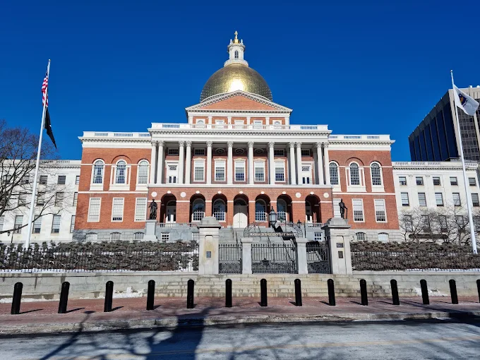

Advocacy
We work hand in hand with Mass Union, as well as CHAPA and others, to advocate for more state-funding.
  This includes not only the operating subsidy but also funding for Resident Service Coordinators.
We also advocate for legislation that will provide for quality of life improvements and the ability to create more public and affordable housing.

Slide 3
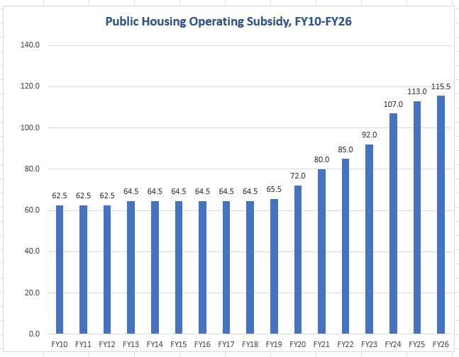

Slide 4
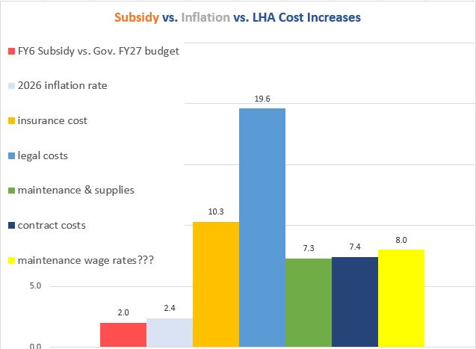
Source: EOHLC 2025 LHA budget data

Slide 5
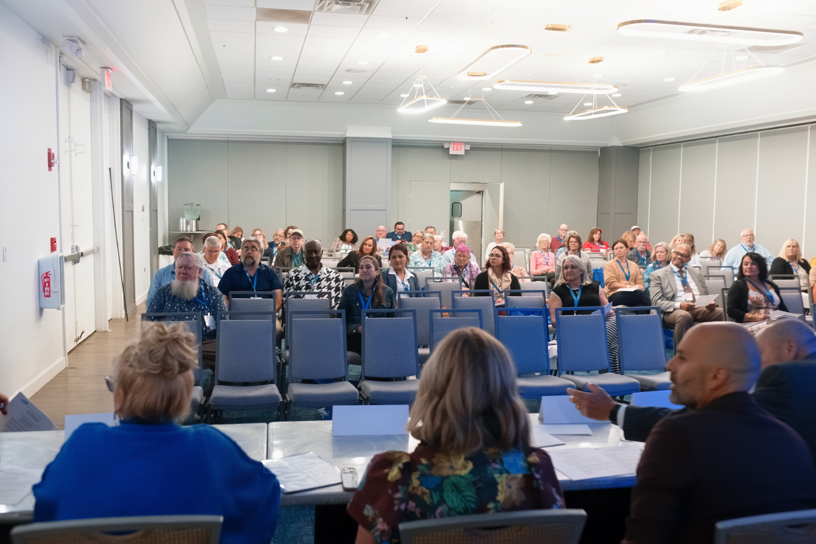
Trainings
We also provide housing authority and their staff with the training they need to better serve residents.
^{These trainings include:}
  ^{Rent Calculation Trainings}
  ^{Board Member Trainings}
  Reasonable Accommodations trainings, deescalation trainings, trainings on identifying and stopping bullying, and many more!

Slide 6
Contact
We will continue working with our partners here to ensure everyone has a safe, sanitary, and secure home.
If you have any questions – please feel free to email Cylas Martell-Crawford at cmartellcrawford@massnahro.org

