Slide 1
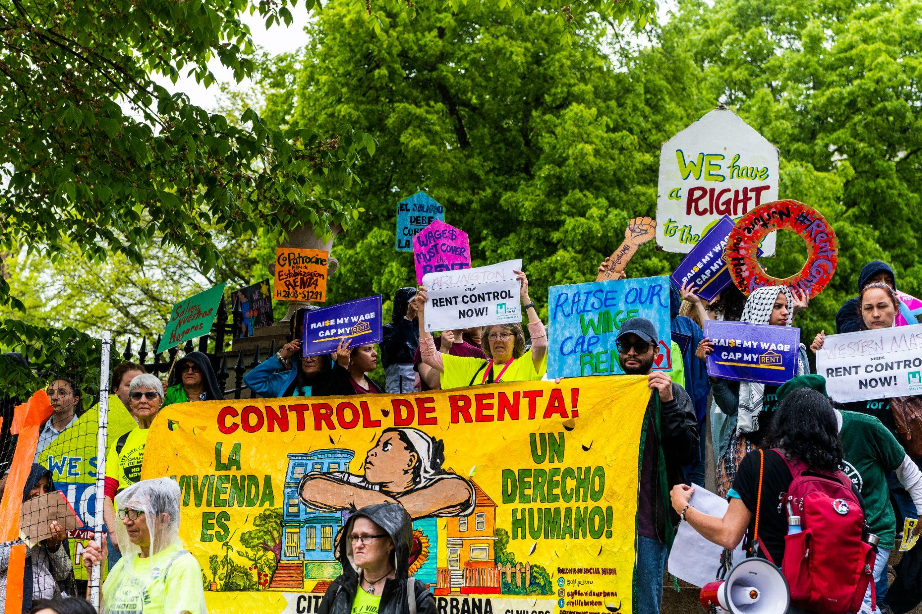
Housing justice is possible!

Slide 2

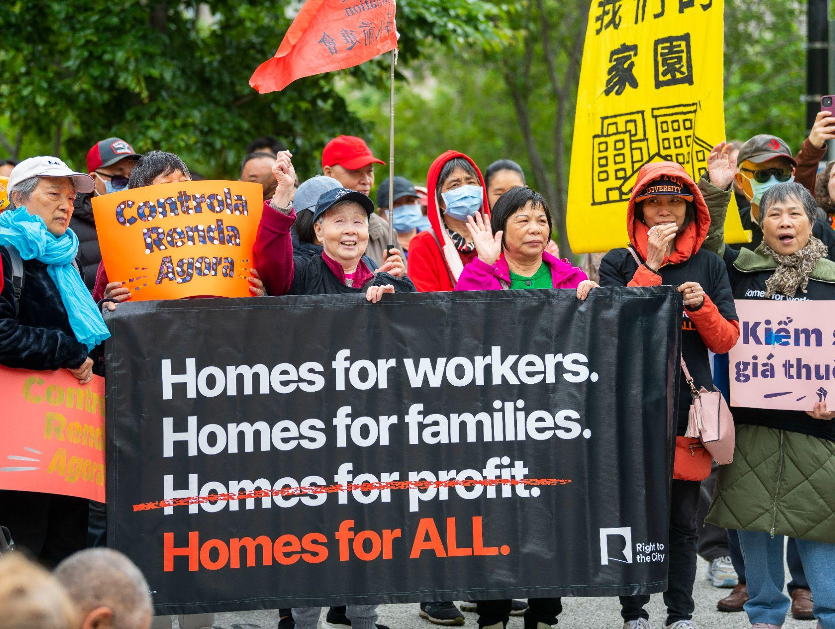
Homes for All Massachusetts
A coalition of tenant organizations
Providing support & expanding tenant organizing across the state and supporting the grassroots housing justice ecosystem to grow
The state policy vehicle for tenant organizing groups statewide (homesforallmass.org/policy)
A coalition of 10 organizations, with growing work in Worcester, Brockton, and other key regions of the state

Slide 3
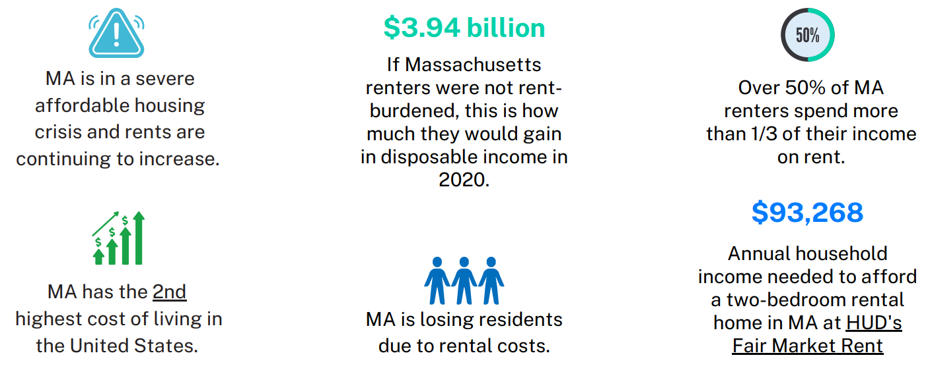
The impact of rising rents in Massachusetts

Slide 4
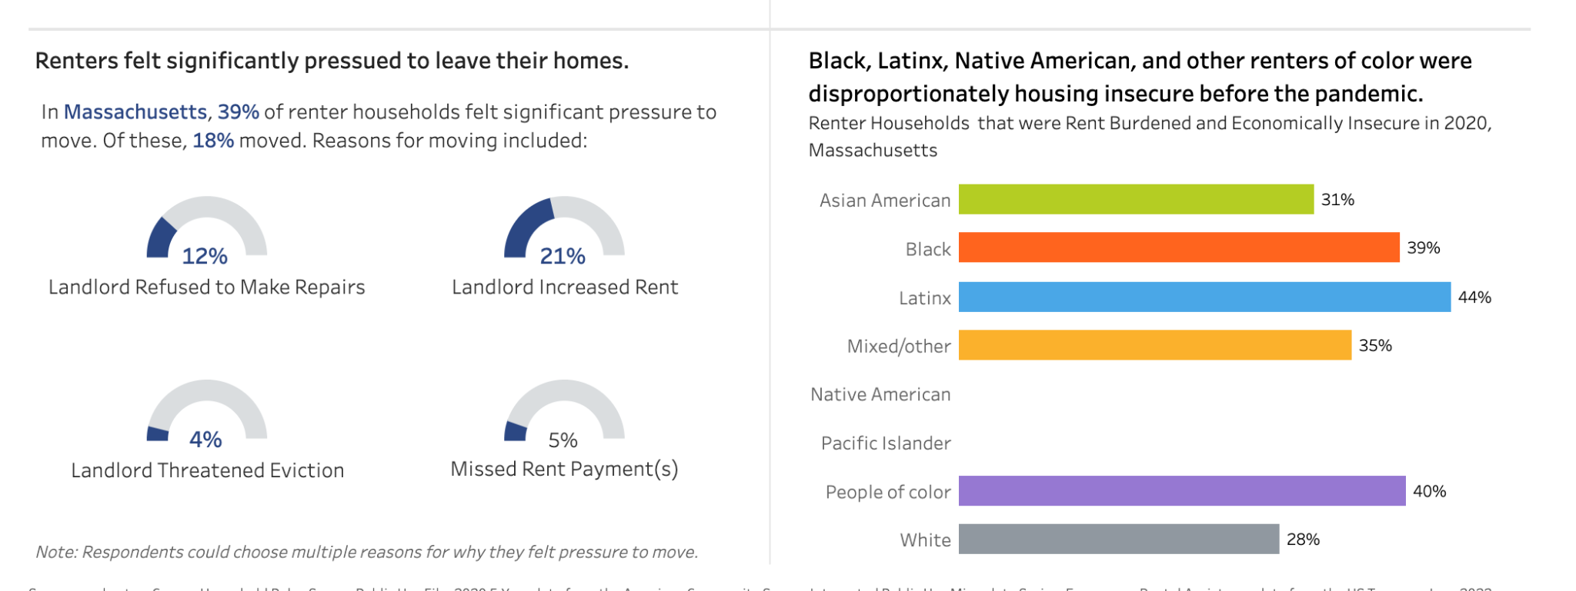
Housing justice is racial justice!
https://nationalequityatlas.org/rent-debt

Slide 5
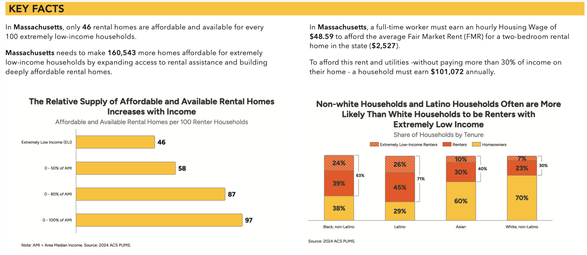

Slide 6
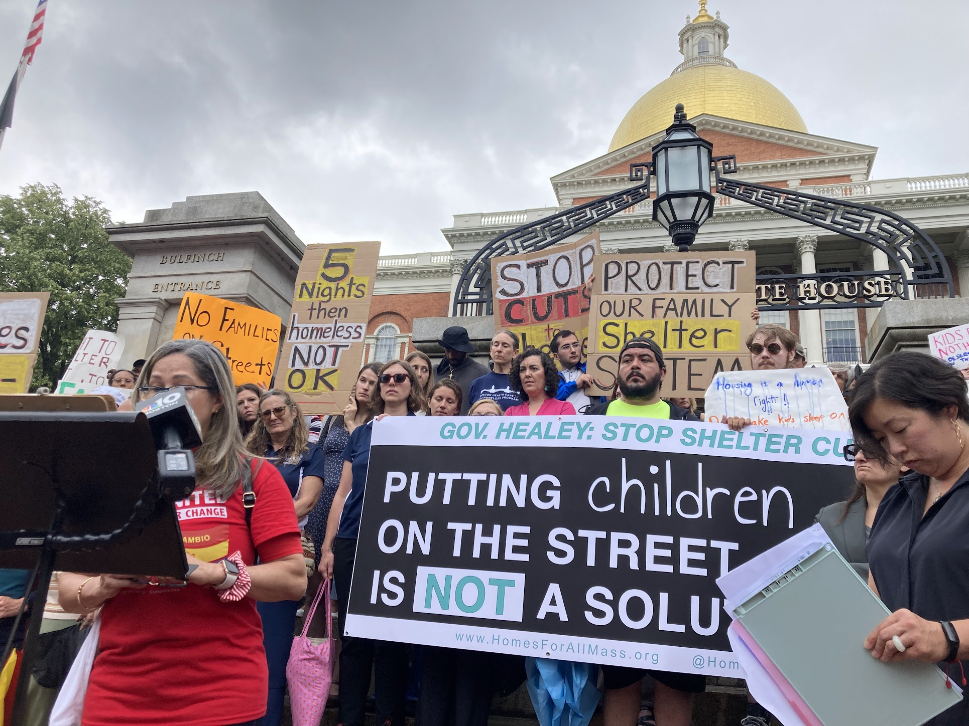
The Housing Crisis…
is actually many interconnected crises.
Our shelter system is struggling to support families & individuals facing homelessness
We don’t have enough affordable housing across the state
Exclusionary zoning laws make it easy for people to oppose new housing
Tenants are facing high rent increases and no-fault evictions
Low-income homeowners are facing foreclosures

Slide 7
Pillars of Housing Justice
Housing justice means establishing a housing system in which housing is a human right, not a commodity to maximize profit. Everyone should have access to affordable, safe housing.
PREVENT DISPLACEMENT
Prevent evictions and foreclosures
Increase tenant protections
Ensure housing is safe, healthy and habitable
PRESERVE AFFORDABLE HOUSING
Fund and maintain existing subsidized and public housing
Protect naturally occurring affordable housing
Support social housing
CREATE MORE AFFORDABLE HOUSING
Create and fund more, and reduce barriers to, quality public, subsidized and permanently affordable housing
Create and fund additional rental vouchers
HOUSE UNHOUSED PEOPLE
Increase access and funding, and reduce barriers to; shelter, supportive housing and rental assistance
Increase funding and support for housing search
PREVENT DISPLACEMENT
CREATE MORE AFFORDABLE HOUSING
PREVENT DISPLACEMENT
CREATE MORE AFFORDABLE HOUSING

Slide 8
Policies that support each Pillar of Housing Justice
PREVENT DISPLACEMENT
Rent stabilization
Foreclosure mediation
Eliminate tenant-paid brokers fees & other junk fees
PRESERVE AFFORDABLE HOUSING
Funds to maintain existing subsidized and public housing
Tenant opportunity to purchase act (TOPA)
Support social housing & community land trusts
CREATE MORE AFFORDABLE HOUSING
Real estate transfer fee
Create additional rental vouchers
HOUSE UNHOUSED PEOPLE
Stop cuts to access to family shelter
Increase funding for HomeBASE & RAFT
Prevent criminalization of homelessness
PREVENT DISPLACEMENT
CREATE MORE AFFORDABLE HOUSING
PREVENT DISPLACEMENT
CREATE MORE AFFORDABLE HOUSING

Slide 9
Public housing is a key part of a just and equitable housing system.
The preservation, protection, and construction of public housing are essential components of these Pillars. The availability of safe, dignified public housing is critical to a future where a human right to housing can be realized.
PRESERVE AFFORDABLE HOUSING
Funds to maintain existing subsidized and public housing
Tenant opportunity to purchase act (TOPA)
Support social housing & community land trusts
CREATE MORE AFFORDABLE HOUSING
Real estate transfer fee
Create additional rental vouchers
PREVENT DISPLACEMENT
CREATE MORE AFFORDABLE HOUSING

Slide 10
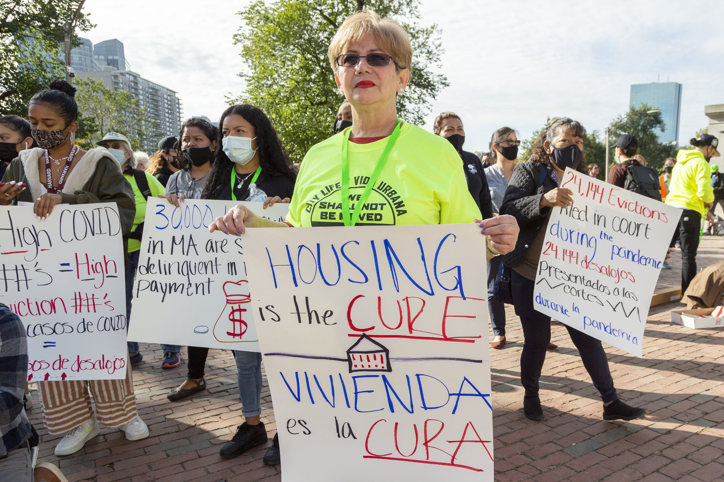
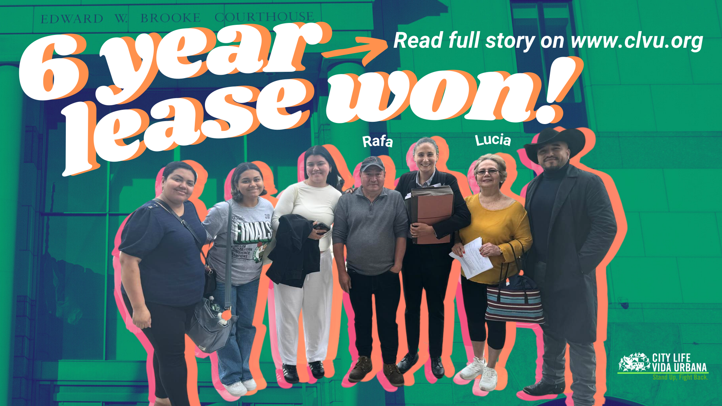
Tenants & community members are building power & winning
Lucia, a tenant in Chelsea, won a 6 year stable lease with annual rent cap of 5% through a combination of organizing & legal strategies
In Somerville, the Community Action Agency of Somerville led a process to develop a rent stabilization home rule petition, leaning on the knowledge of tenants with lived experience
In Worcester, community organizers came together to push for inclusionary zoning in 2022 that would be truly affordable for residents and increase the number of affordable units in the city

Slide 11
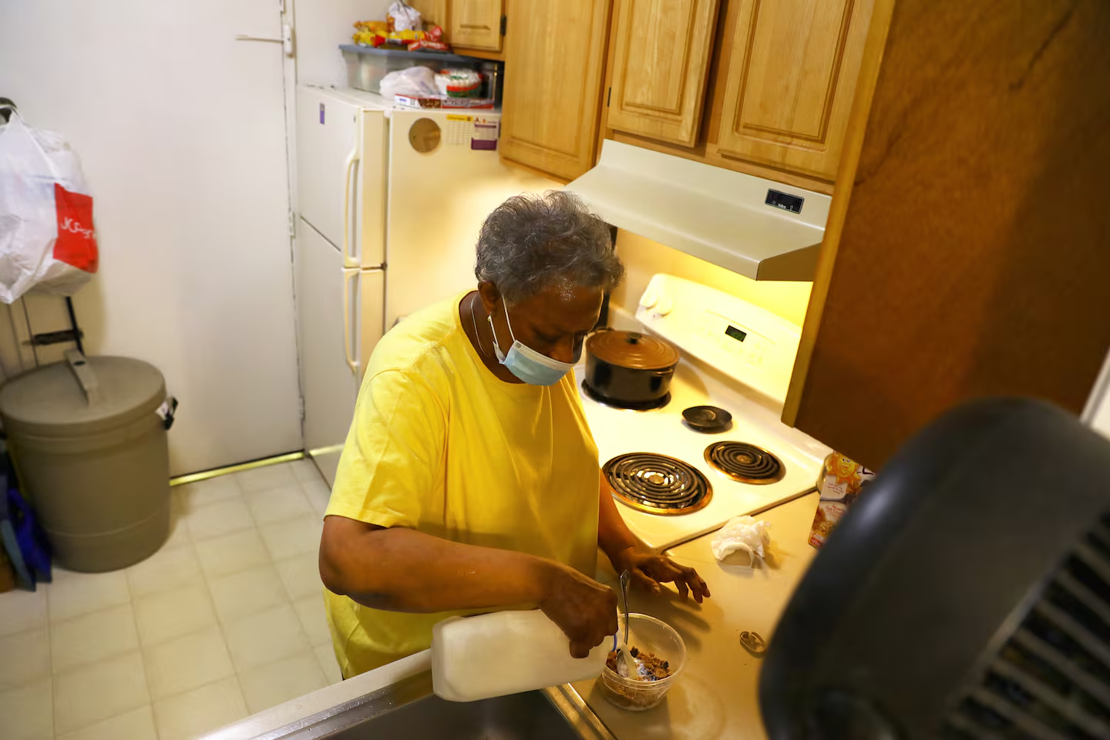
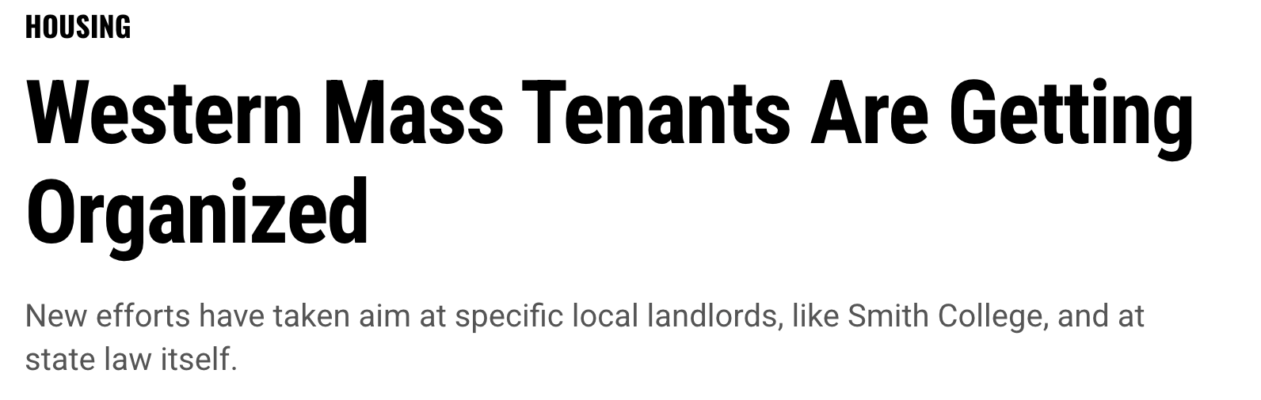
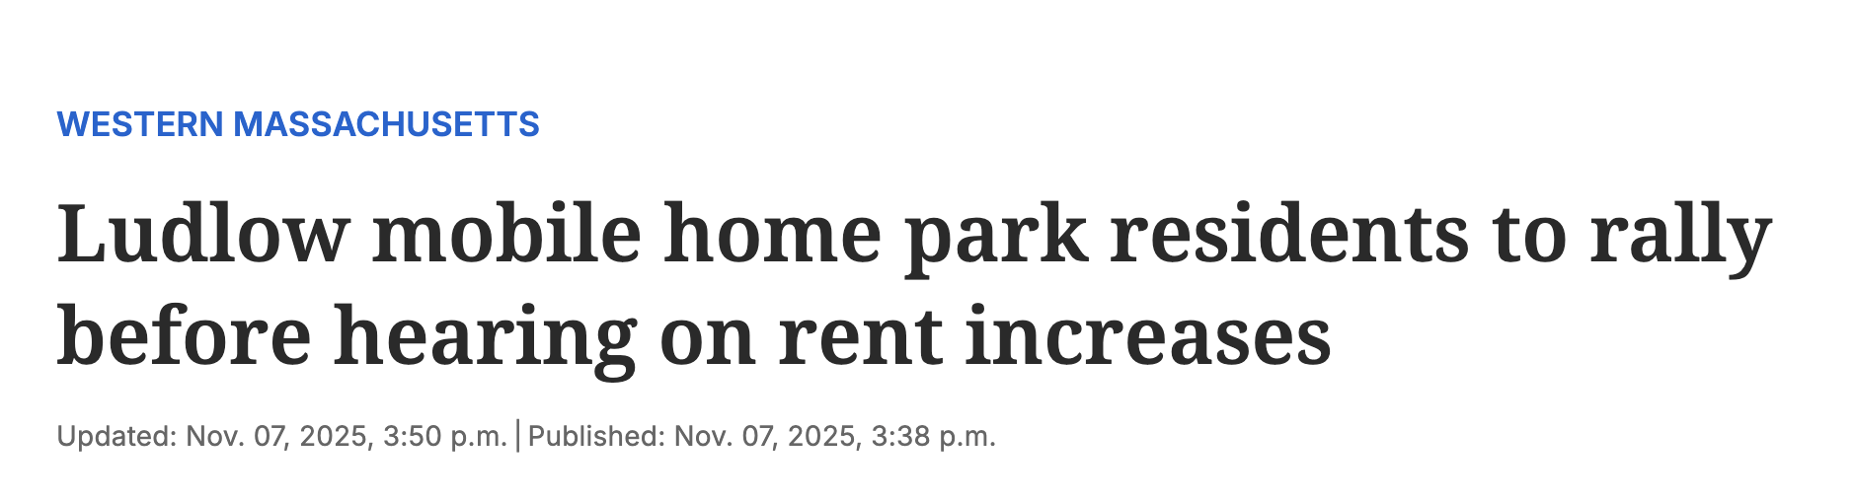
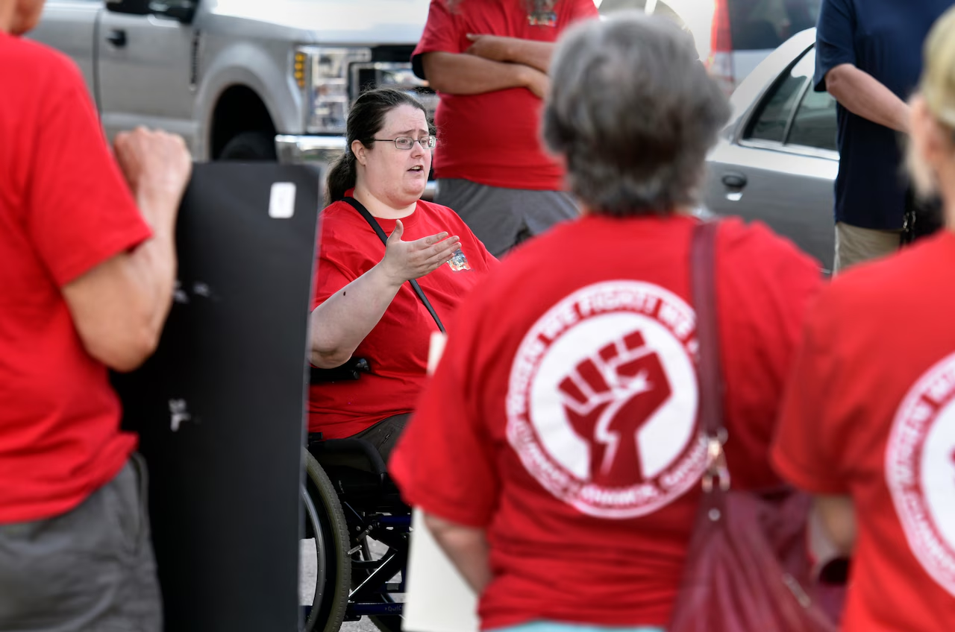
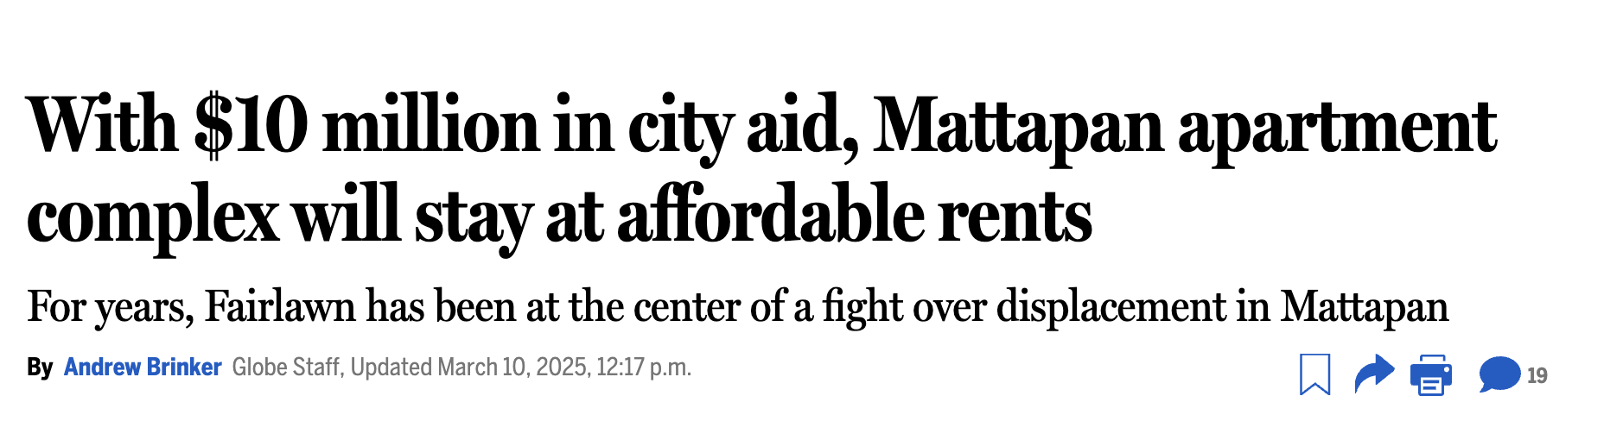
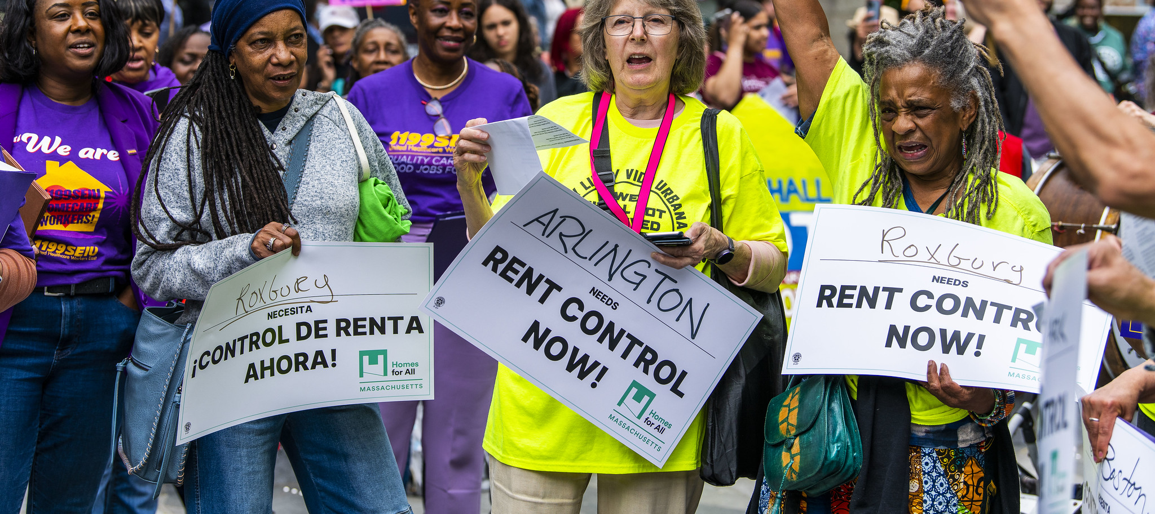

Slide 12
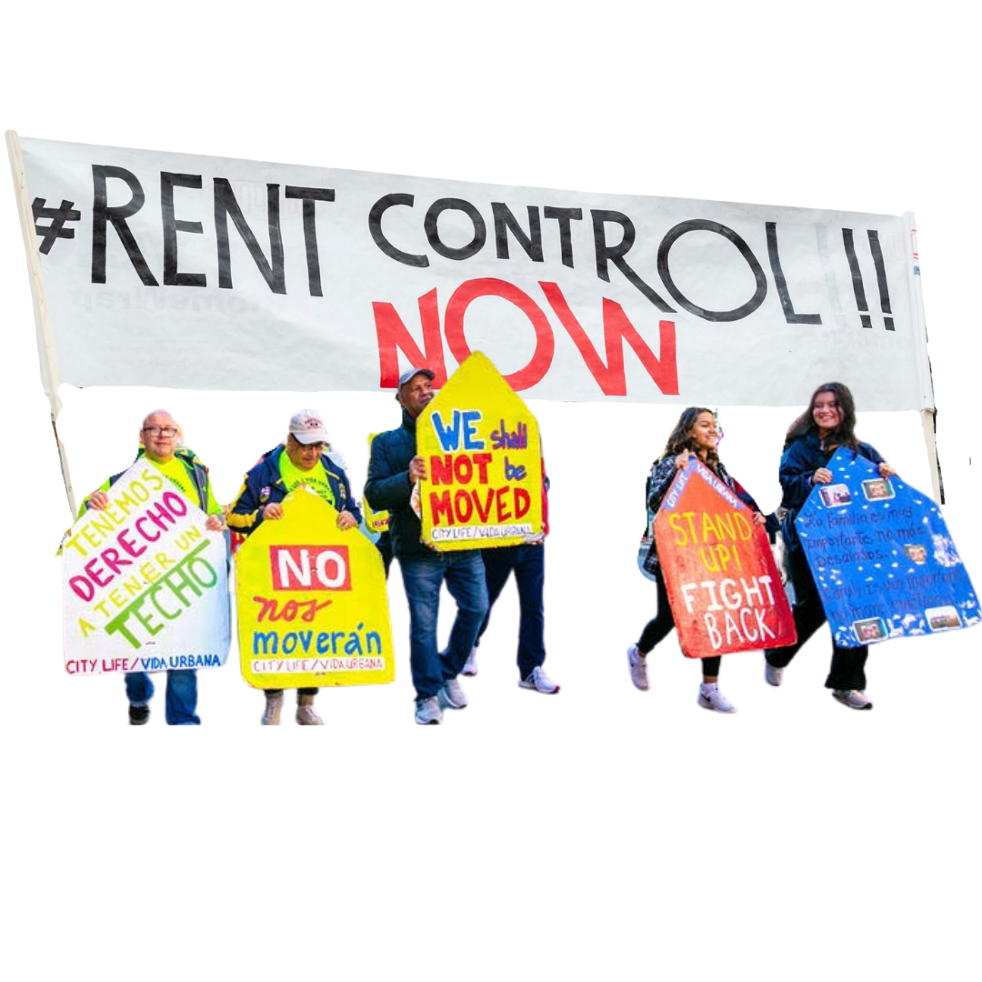
Tenants need rent stabilization
Massachusetts tenants need stable and predictable rents to thrive, not just survive.
Everyone, regardless of what you look like or what zip code you live in, deserves an affordable place to live.
For thirty years, profit-seeking corporate investors have taken advantage of an outdated ban on local rent control, spiking housing costs and making it impossible for many of us to stay in our homes and communities.
We can come together and enact common-sense rent control that would immediately increase housing stability for hundreds of thousands of residents and advance racial and economic justice.

Slide 13
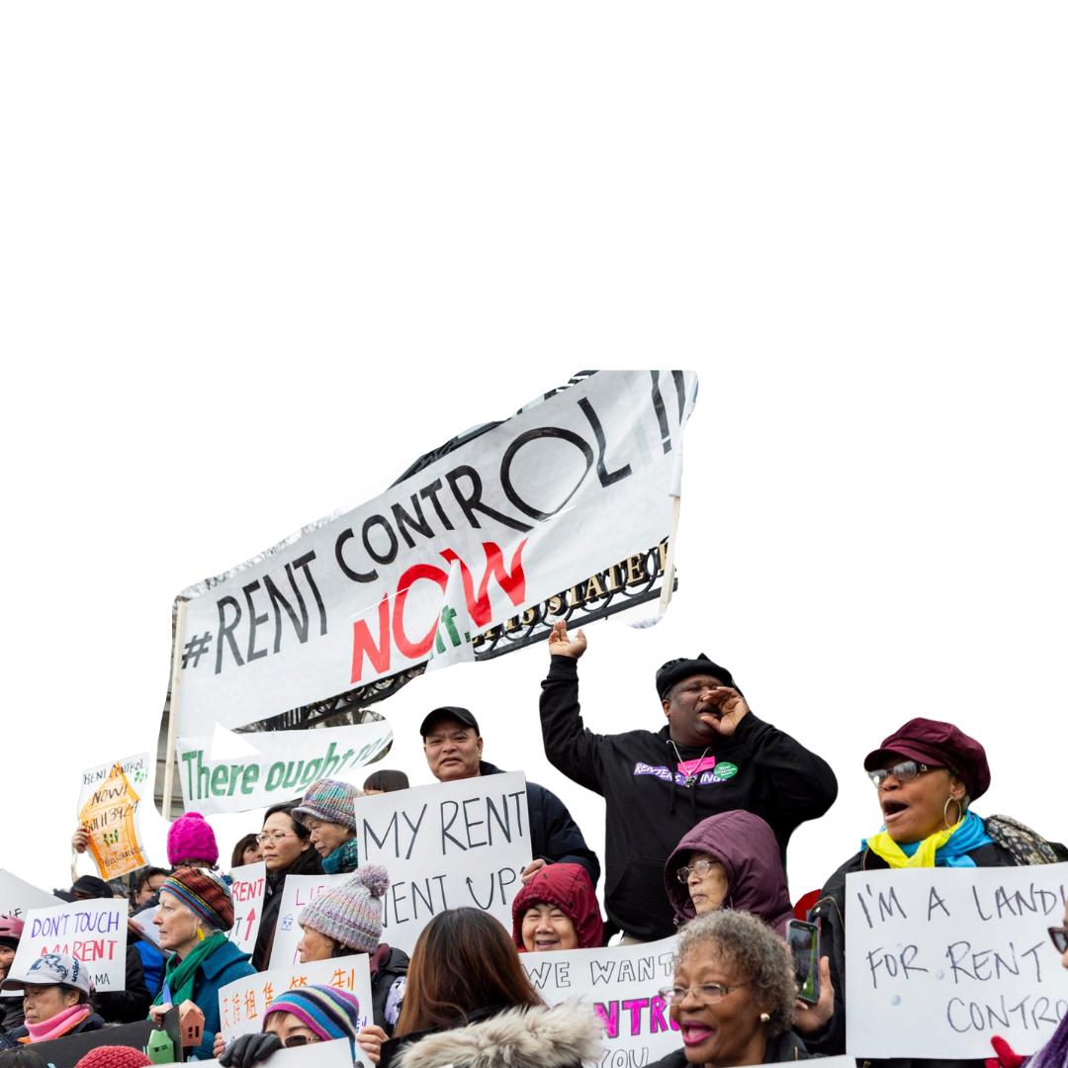
Rent stabilization and our collective power
Rent control and rent stabilization bills have been filed for several legislative sessions and momentum and public support are increasing quickly as housing costs skyrocket
Cities and towns are looking for ways to help stabilize their communities and are looking to rent control
Home rule petitions to enact local rent stabilization have already passed in Somerville, Boston and Brookline, and several others are working on local ordinances

Slide 14
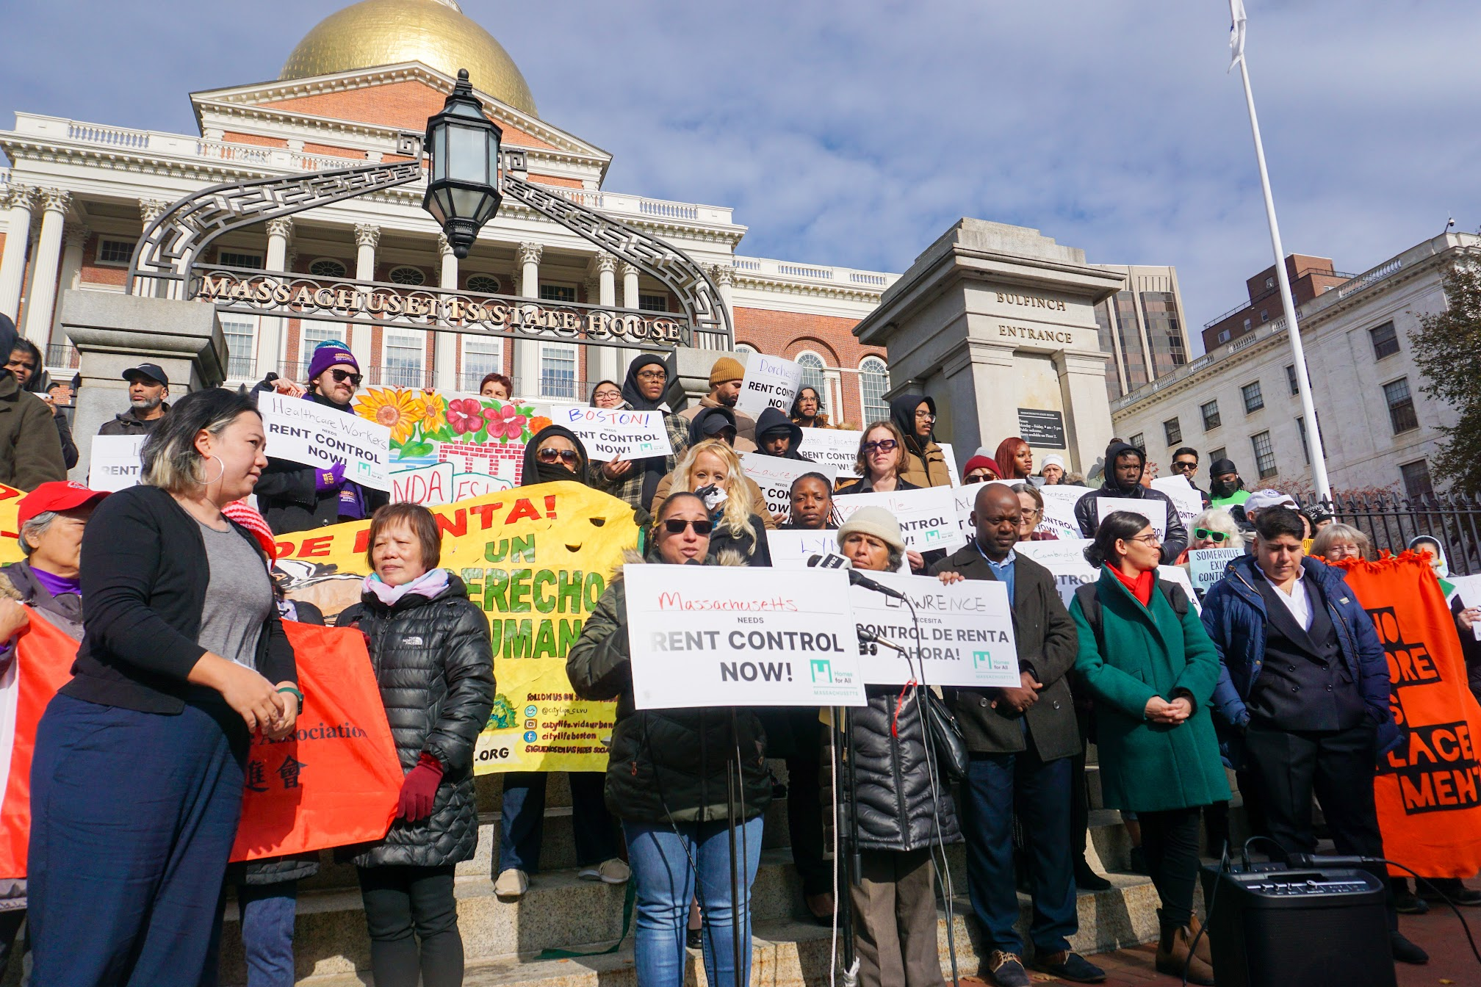
We are building the movement to WIN!

Slide 15
Keep in touch!
carolyn@homesforallmass.org
andrea@homesforallmass.org
@KeepMassHome
@Homesforallmass

