Slide 1
Know Your Rights & Bystander Rights
2026

Slide 2
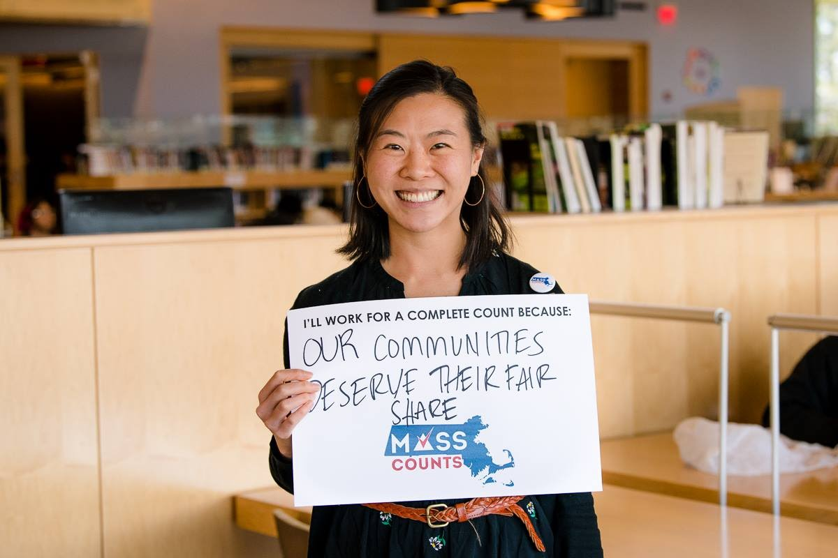
About MIRA:
Our vision is a Commonwealth – and a nation – where all can thrive, no matter where they came from or how they got here, and all can fully participate in their community’s social, economic, and civic life.
State legislative and budget advocacy
Federal advocacy
Training & capacity building
Immigration helpline & MACI program

Slide 3
Quick Overview of Immigration Enforcement

Slide 4
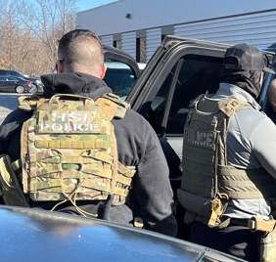
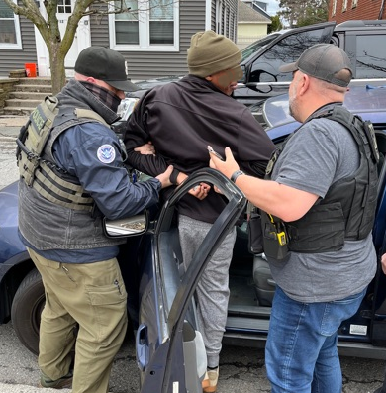
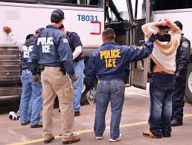
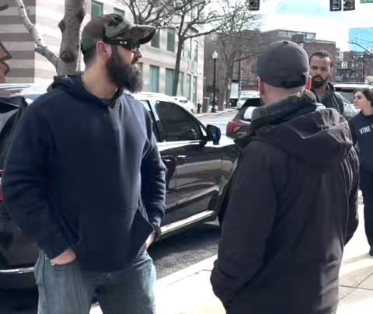
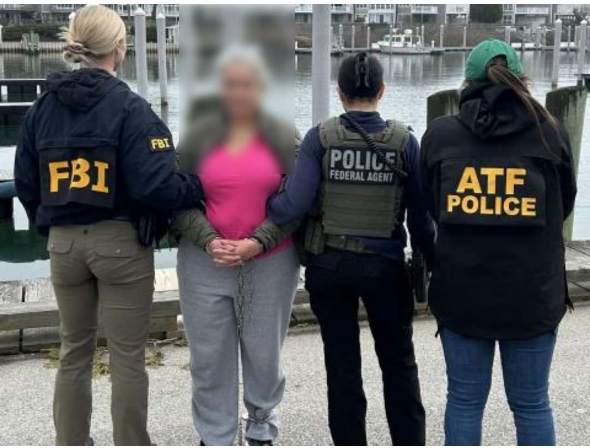
What does immigration enforcement look like?

Slide 5
How People May Come into Contact with Immigration Enforcement
Contact with the criminal system
  ICE presence after arrest
  ICE presence in and outside criminal courts
Applying for a benefit at USCIS, especially while having a removal order or criminal charge
Green card and visa holders returning from travel
Raids & targeted enforcement

Slide 6
Know Your (and Everyone’s) Rights

Slide 7

Basic Rights
Everyone living in the U.S. has certain basic rights under the U.S. Constitution, regardless of immigration status
It is important to assert these rights when safe to do so

Slide 8
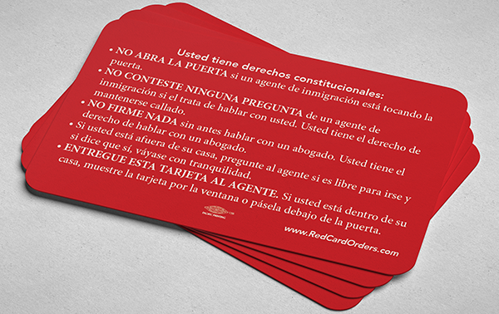
Rights Card
Asserting the right to remain silent can be difficult.
It’s helpful for people to have a rights card in their wallets that they can reference.

Slide 9
When does immigration need a warrant?
ICE needs a judicial warrant to:
  Enter someone’s home
  Enter a private space
ICE does not need a judicial warrant to arrest someone in a public place (including in a car) if:
  they have an administrative warrant or
  they have probable cause to believe the individual has violated immigration law and is a flight risk

Slide 10

If Immigration Comes to Your Home...
Do not immediately open the door:
Legally, you do not need to open the door unless the officer provides you with a warrant signed by a judge.
Ask officers to identify themselves (agency, name, ID)
Ask if they have a warrant signed by a judge
Slide a “Know Your Rights” card under the door
You have the right to remain silent and to an attorney. If you choose to invoke that, state to officers “I request my right to silence and to an attorney.”
Call a US citizen friend or family or an attorney

Slide 11
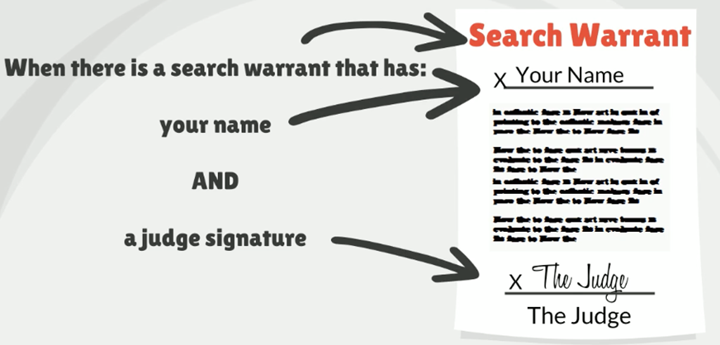
When can Law Enforcement enter my home?
Judicial Warrant

Slide 12
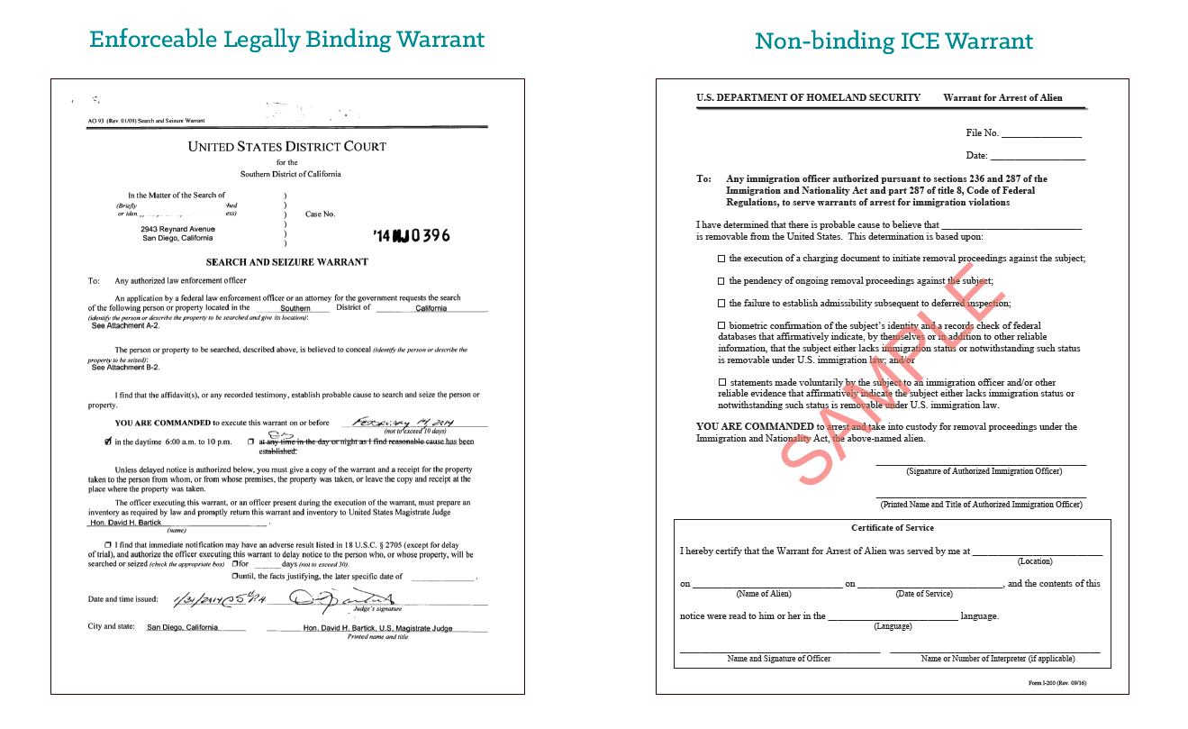

Warrants
Example of judicial warrant
Example of administrative warrant

Slide 13
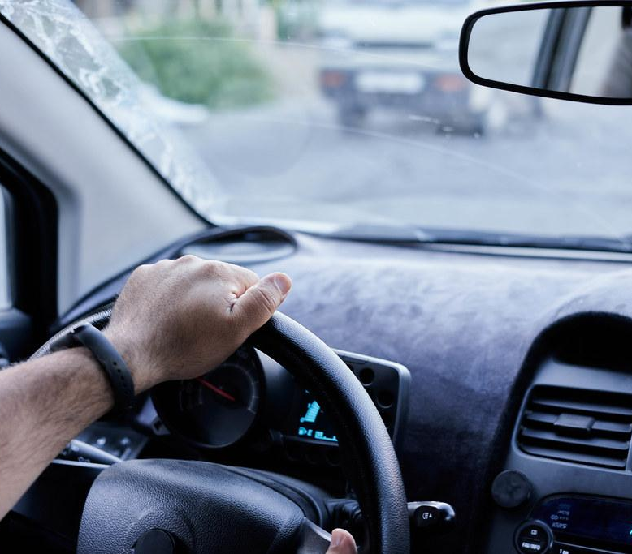
If You Are Stopped When Driving…
If you live in Massachusetts you are eligible to get a driver’s license regardless of immigration status!
Stay in the car. Place your hands on the steering wheel so the officer can see them.
In MA, the driver must provide name and address. You do not need to answer any questions. Passengers can remain silent.
Police can search your car if they have probable cause to believe you have been involved in a crime. You can state clearly that you do not consent to a search.
Never provide false documents.

Slide 14

If Immigration Stops You in Public…
Stay calm - Do not run or resist arrest!
Ask if you are under arrest or free to leave.
Remain silent and say you want to speak to an attorney.
You have the right not to be fingerprinted unless you’re being arrested.
Police can search you if they have a reasonable suspicion that you are armed and dangerous.
Never provide false documents.

Slide 15
If Immigration Comes to Your Work…
Workplaces sometimes have private and public areas
  Private: back offices, kitchen of a restaurant
  Public: dining area of a restaurant, lobby
ICE needs consent or a judicial warrant to enter a private/restricted area of your work
  “I can’t give you permission to enter. You must speak with my employer.”
You have the right to remain silent
ICE will sometimes ask workers to sort themselves by status:
  Workers or employers do not have to comply with these requests or identify specific workers.
More information for employers

Slide 16
When does one need to show documents?
If you are 18 or older, you must carry your immigration documents with you at all time.
  You must show your immigration documents when asked for them.
  Originals?
If you do not have immigration documents, you have the right to remain silent. You don’t need to answer any questions about your status, where you were born, or when you came to the United States.
Note that different rules apply at immigration checkpoints and at ports of entry

Slide 17
How to Be Prepared
Know your rights in case an officer asks you questions or comes to your home.
Memorize phone numbers for your family members and/or an attorney/organization that you trust. You might only be able to make one phone call while detained!
Think of a U.S. citizen or someone with immigration status that you trust who can pay bond if you are granted one by an immigration judge.

Slide 18

Arrest and Detention
If you are arrested or detained, DO NOT:
  Sign anything or take “voluntary departure” without the guidance of a lawyer
  Rely on immigration agents to provide you with information about your rights; ask a lawyer for facts.
You have a right to:
  Remain silent.
  Call a lawyer or family member
  Be visited in detention by a lawyer
  Contact your consulate
You can use the online detainee locator (locator.ice.gov) to find someone who has been detained by immigration

Slide 19
Release on Bond
Immigration enforcement can choose to place individuals it is trying to deport in immigration detention
If detained, many individuals are able to request release on bond. Release on bond means you can be at home while your case is pending, and go to court for the hearings.
  You can request the immigration judge to review the bond decision
  It helps to show strong family and community ties
  Only someone who is a US citizen or has lawful immigration status should go to immigration to pay the bond

Slide 20
2. Being a Bystander

Slide 21
Being a Bystander
ACCOUNTABILITY
Inform the community
Document abuses
SUPPORT
Offer support to impacted individuals

Slide 22
Safety First
If you feel it is not safe for you to be a bystander, you can calmly leave the situation
If you choose to act as a bystander:
  Project Calm
  Keep People Safe
  Gather Evidence
Some bystanders will choose to engage in activities which are unlawful.
This training provides information about what bystanders are lawfully authorized to do.

Slide 23
3. Create Accountability

Slide 24
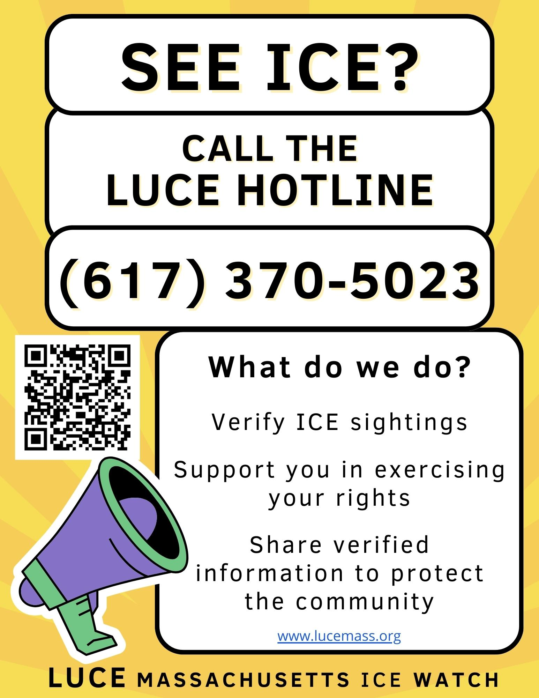
Call LUCE

Slide 25
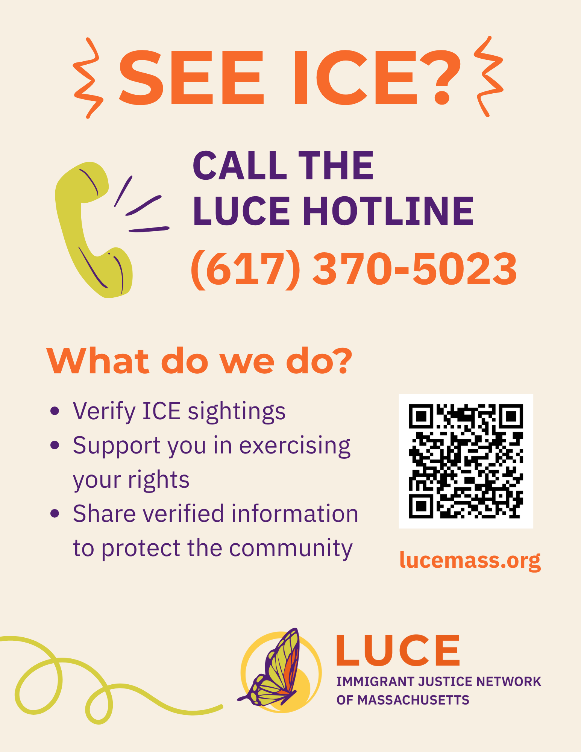
Share Information
Where exactly are the agents?
How many immigration or law enforcement agents are there?
What are the agents doing?
How long have the agents been in that location?
What, if anything, do you know about the person being detained?

Slide 26

Record what is happening
First Amendment right to record law enforcement in public spaces
  Must be from a reasonable distance. If an officer asks you to step back, you should comply with the order, but may continue recording.
  On private property, an owner may ask you to leave. Note that in some public spaces recording is prohibited (ex: courthouses)
  If a law enforcement officer seizes a bystander’s recording device, they need a judicial warrant to gain access to the device or recording.
    Consider locking phone with a password instead of face recognition
Capture any identifying information:
  Agency vests
  Uniform insignia
  Badge numbers
  License plates
After the fact, capture reactions from bystanders

Slide 27

Take notes
Who was there?
How many people?
How long did it take?
Describe the officers
Describe the number of cars
Any damage to cars?
Any harm to people?

Slide 28

In the moment
Ask questions (even if you don’t get answers)
  What agency are you with?
  What are your names and badge numbers?
  Do you have a warrant?
  Can I see your warrant?
    Note: they are not required to show it to you
  Where is this person being taken?
You have the right to remain silent
  ICE/law enforcement can ask a bystander questions, but they are under no legal obligation to answer

Slide 29
4. Provide Support

Slide 30
In the moment
Remind people of their rights (don’t tell them what to do):
You have the right to remain silent!
You have the right to refuse search without a warrant
You have the right to contact an attorney
You have the right to not sign anything without consulting with a lawyer first
You have the right to contact your consulate

Slide 31
Ask how you can support
Who can we call?
  Ask about language access needs
Do you have a lawyer?
  Get their name and phone number
Confirm permission:
  Do I have your permission to call your family?
  Do I have your permission to call your lawyer?
  Do I have your permission to share this video?

Slide 32
After the fact
Contact emergency contact (if provided)
Assist family in finding their loved one in the immigration detention system. You can use the online detainee locator (locator.ice.gov) to find someone who has been detained, though information is often delayed.
Reach out to local community organizations that can provide support or mutual aid

Slide 33
5. What you don’t have a right to do

Slide 34
You don’t have the right to:
Physically interfere:
  Pushing or otherwise touching an ICE/law enforcement officer
  Blocking an ICE/law enforcement officer
  Putting your body between the officer and the individual
  Hiding the person that ICE/law enforcement is attempting to detain
Your actions as a bystander can affect a person’s case.

Slide 35

What you should not do:
Do not run
Do not escalate the situation
Your actions as a bystander can affect a person’s case.

Slide 36
6. Prepare in Advance

Slide 37
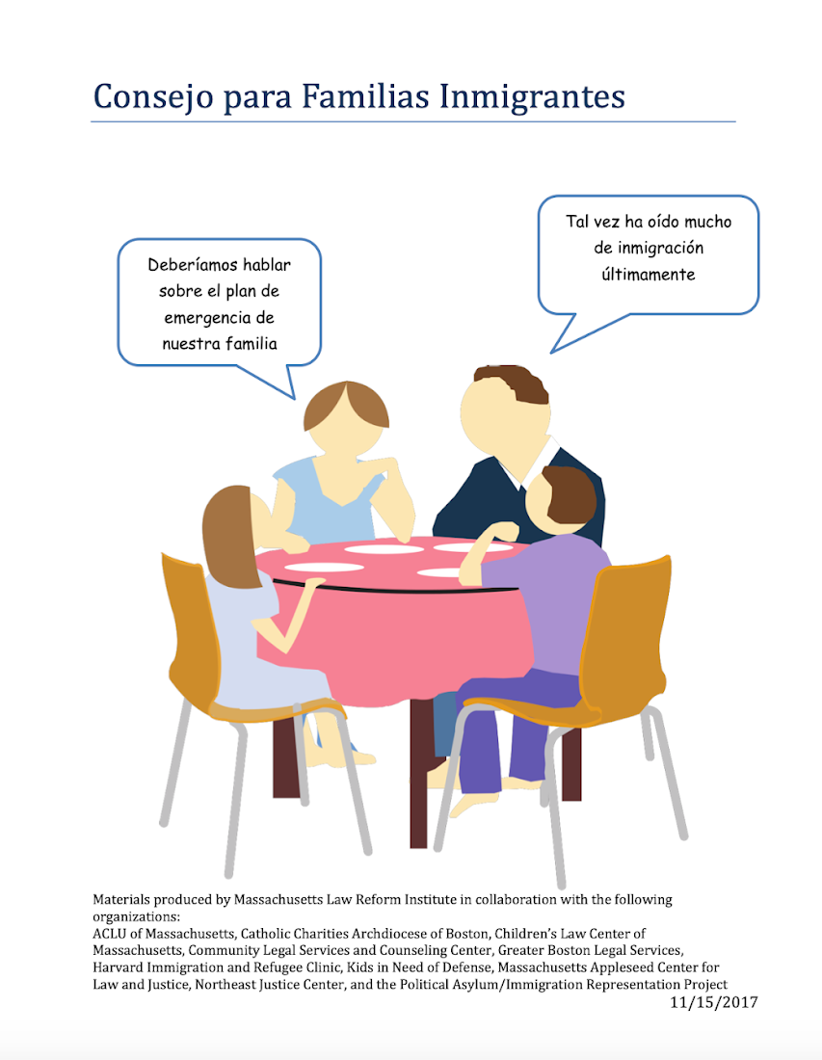
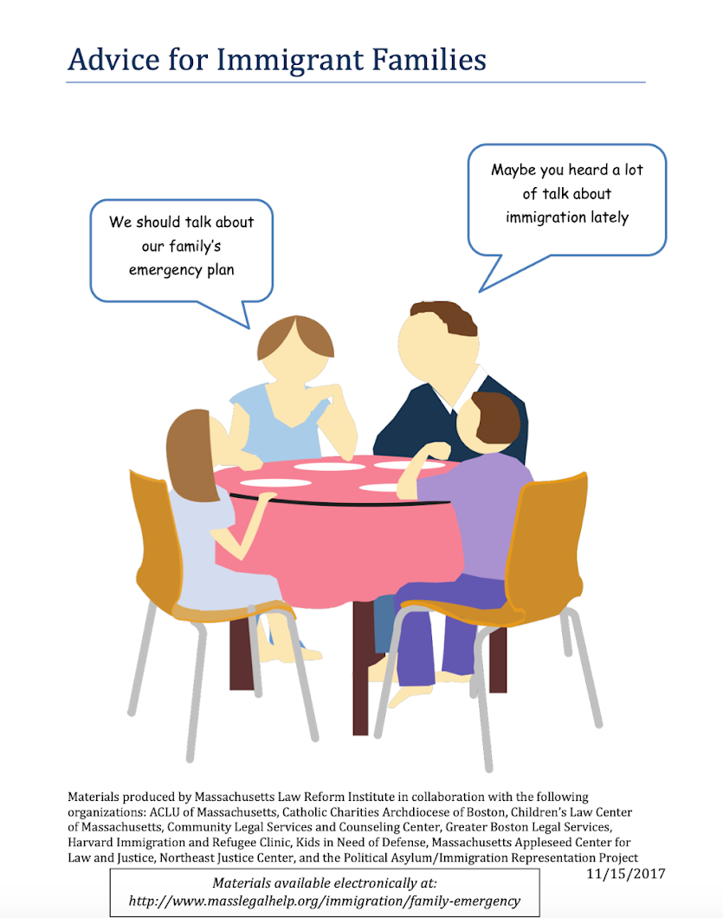
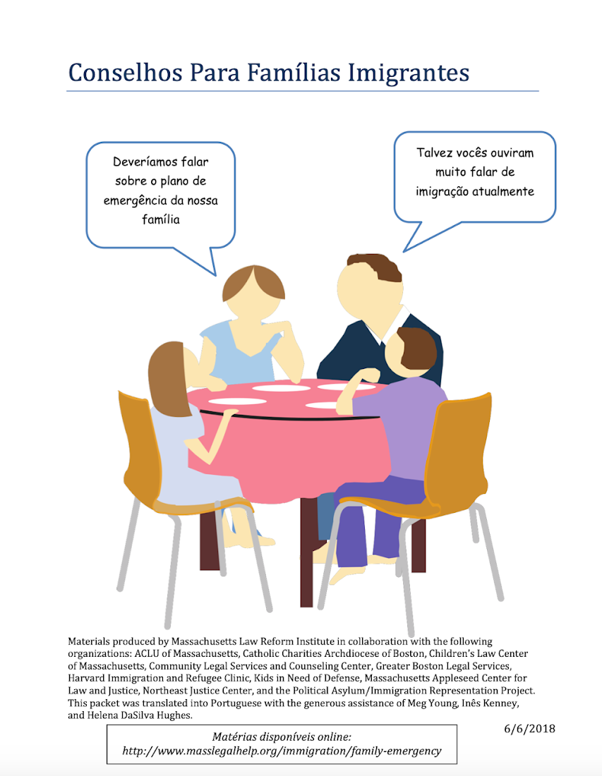
Family Preparedness
Massachusetts Family Preparedness Packet

Slide 38
Family Preparedness
What is a Family Preparedness Plan?
  Safety plan that offers parents and caregivers facing the threat of detention or deportation the opportunity to make decisions about:
    Who will care for their children in their absence
    Plans for meeting child’s educational, medical, and emotional needs in your absence
    Plans for reunification

Slide 39
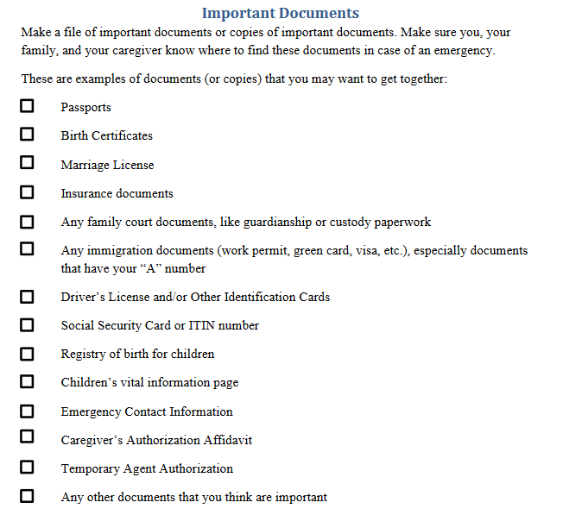
Immigration documents are important!
Some documents have A numbers or dates for hearings or other immigration appointments - this information is very important!
It may be helpful to let others in the family know where these documents are kept.

Slide 40
How you can help
Sit with someone while they complete a Caregiver Authorization Affidavit or help them connect with a provider who can assist them and/or a notary public
Help someone gather and organize their documents, make copies, and keep them in a safe place
Help someone obtain passports for their children
Offer to be someone’s emergency contact - be prepared!
Offer to be the temporary caretaker for someone’s children

Slide 41


Prepare in Advance if Immigration Enforcement Arrives
Is your workplace, school, or community organization prepared?
Create an internal response protocol that clearly explains what steps need to be taken in the event of ICE presence.
Train all staff - especially any front desk staff - on the response protocol.
Consider posting signs that clearly mark certain spaces as private.
More resources for employers, educators, and service providers on MIRA’s Know Your Rights page!

Slide 42
8. Resources

Slide 43


MIRA Immigration Helpline
Only answer general immigration questions.
Not a legal form of representation.
Not a number to call in an emergency.
https://miracoalition.org/news/immigration-helpline/

Slide 44

Boston Immigrant Justice Accompaniment Network
Accompaniment to individuals interacting with the immigration system:
Accompaniment in court or at ICE check-ins
Legal referrals
Rides for families to visit loved ones in detention
Immediate needs of people released on bond who have no other resources in the community.
A hotline for individuals in detention and for family members of an individual in detention
Detained hotline: (617) 637-8195
Family hotline: (617) 396-7143‬
Assistance through the Beyond Bond and Legal Defense Fund:
Logistical assistance with paperwork or bond payments
Contributions for bond or legal fees
Letters of support from the community
Connection to free representation in bond proceedings through the Legal Representation Fund

Slide 45

Massachusetts Access to Counsel Initiative
Joint effort between MIRA Coalition, CPCS, and a statewide network of legal organizations.
Centralized intake and referral system for individuals in Massachusetts facing Immigration Court proceedings.

Slide 46

PAIR Project
The PAIR Project provides free or low-cost legal assistance for detained individuals at the Plymouth and Wyatt county jails.
You can contact PAIR regarding a detained individual by sending an email to detention@pairproject.org or calling their intake line at 617-742-9296. Hours of operation are 11 am - 3 pm most days of the week.

Slide 47
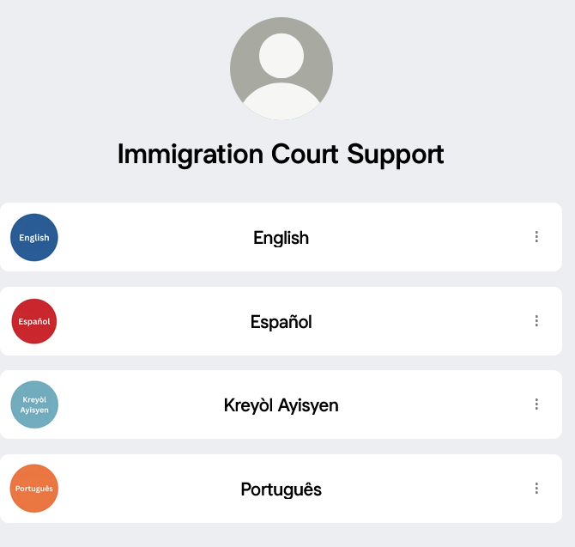

Resources for immigration court
bit.ly/immcourtsupport

Slide 48
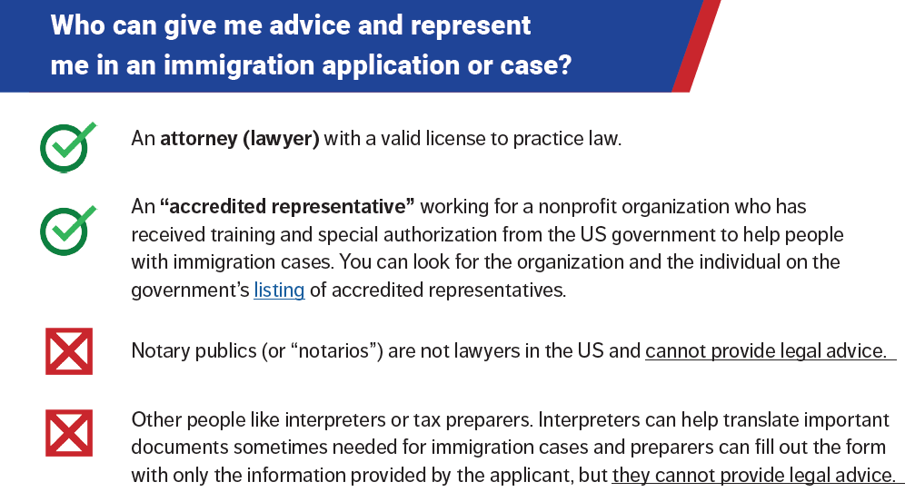

Slide 49

Immigration Legal Resources
Legal Services Directory in Massachusetts:
  Massachusetts Legal Resource Finder: https://masslrf.org/en/home
  Immigration court list of legal services: https://www.justice.gov/eoir/file/ProBonoMA/download
  City of Boston free consultations: https://www.boston.gov/departments/immigrant-advancement/free-immigration-consultations
Legal Services Directory Outside of Massachusetts:
  Immigration Advocates Network Legal Directory: https://www.immigrationadvocates.org/legaldirectory/

Slide 50
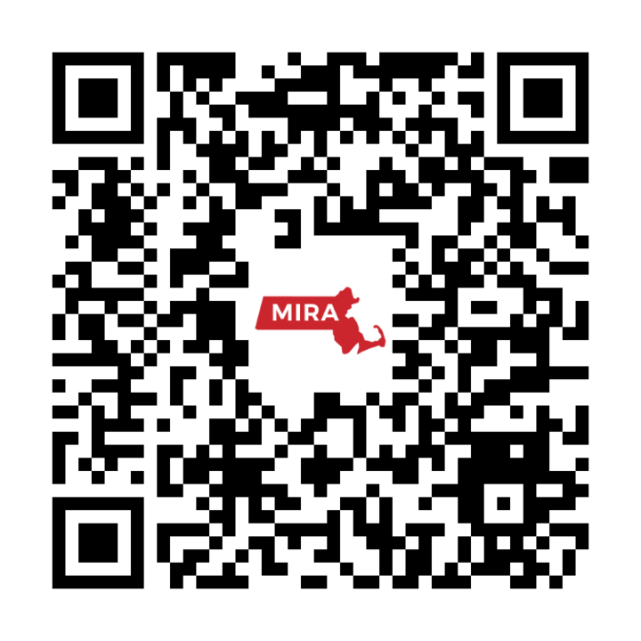
ACT NOW!
Sign the MIRA Petition and get informed about policy changes and upcoming actions and volunteer opportunities.

Slide 51
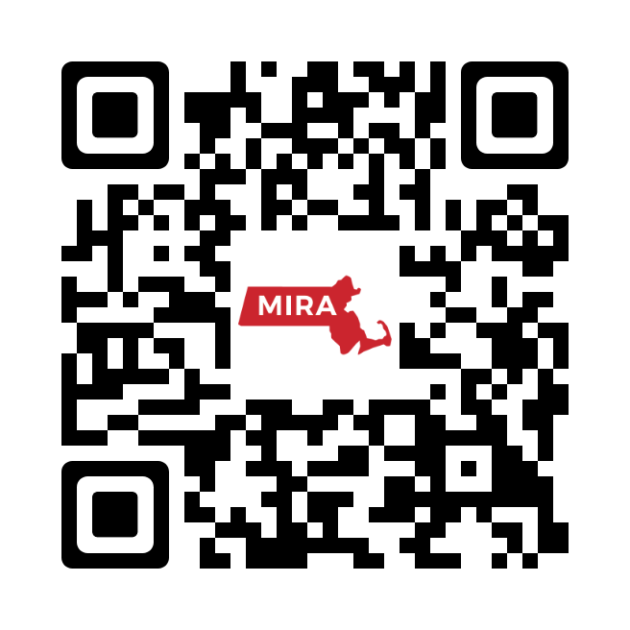
More KYR Resources

