Slide 1
ORI Know Your Rights - updated
Q&A on Immigration
This presentation is for informational purposes only. For legal advice, please contact an attorney.

Slide 2
Overview of Department of Homeland Security
Immigration & Customs Enforcement
Customs & Border Protection
U.S. Citizenship & Immigration Services
Immigration Police / Enforcement, Detention & Deportation, representing the DHS in immigration proceedings
Enforcement at the border and within 100 miles of the border, checkpoints, and ports of entries
Adjudicates petitions for immigration benefits (asylum, green cards, citizenship, special visas)
This presentation is for informational purposes only. For legal advice, please contact an attorney.

Slide 3
Interactions with Immigration Enforcement
This presentation is for informational purposes only. For legal advice, please contact an attorney.

Slide 4
Overview of ICE Authority
ICE is subject to different, but similar, rules as other Law Enforcement
ICE is a federal law enforcement agency
ICE’s authority is generally limited to immigration related enforcement, unless acting in concert with federal or state law enforcement, or investigating crimes through ICE criminal investigative units
When carrying out its enforcement activities, ICE officers must follow different, but similar rules as other law enforcement agencies.
ICE officers must adhere to constitutional restrictions, as well as restrictions set by statutes, regulations and policies.
Individuals engaging with ICE have rights including: (i) the right to remain silent; and (ii) the right to an attorney – though ICE is not required to provide one.
This presentation is for informational purposes only. For legal advice, please contact an attorney.

Slide 5
Basic Rules Surrounding ICE Authority
ICE can demand identification:
Immigrants often must carry identification on them, including copies of a green card and/or proof of registration.
Depending on the facts and circumstances, ICE officers, when they have probable cause to believe a person is here unlawfully, can ask for identification.
ICE can interrogate:
ICE officers may interrogate a noncitizen or person believed to be a noncitizen as to their “right to be, or to remain in the United States” without a warrant. (NOTE: individuals have a right to remain silent and to a lawyer even if undocumented).
ICE cannot approach any individual based on race or nationality alone. However, ICE can approach a person based on factors unknown to the interrogated person.
This presentation is for informational purposes only. For legal advice, please contact an attorney.

Slide 6
Rules Surrounding ICE warrants
Rules differ depending on location of arrest
ICE has warrant requirements and warrant exceptions
This presentation is for informational purposes only. For legal advice, please contact an attorney.

Slide 7
ICE Warrant Requirements – Basic Rules
ICE must have an administrative warrant to arrest someone on the streets if they do not have evidence to believe the person is a flight risk
3
ICE must have a judicial warrant to enter a home
2
ICE need only have reasonable suspicion to stop a car where they believe the driver or the passenger is a person present unlawfully
1
This presentation is for informational purposes only. For legal advice, please contact an attorney.

Slide 8
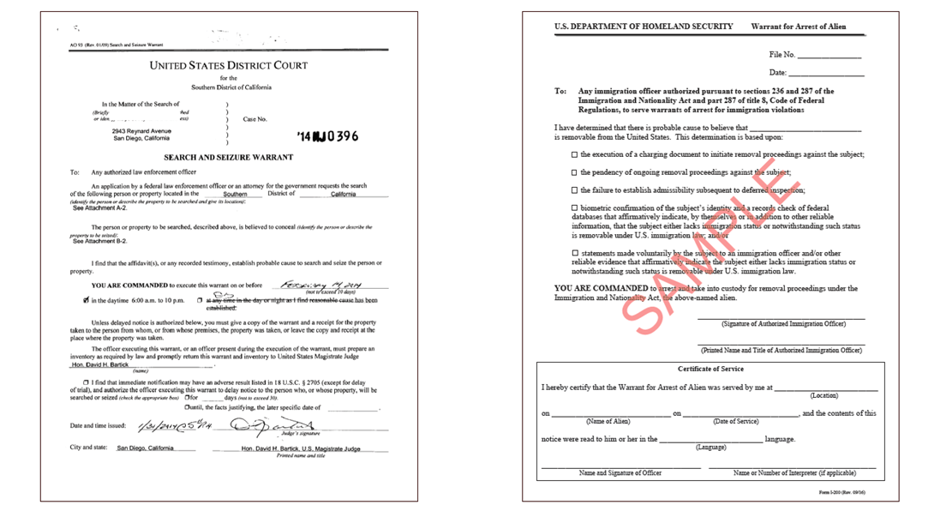
Judicial Warrants v. ICE Administrative Warrants
EXAMPLE OF ICE ADMINISTRATIVE WARRANT: DOES NOT GIVE IMMIGRATION PERMISSION TO ENTER HOME
EXAMPLE OF WARRANT SIGNED BY A JUDGE
This presentation is for informational purposes only. For legal advice, please contact an attorney.

Slide 9
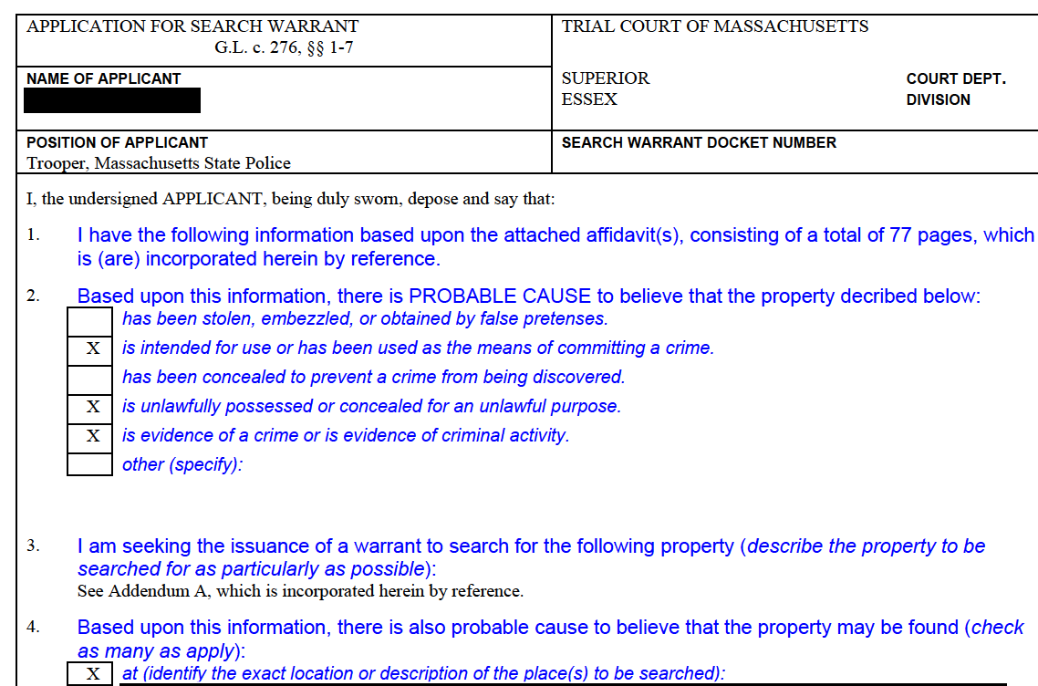
State Judicial Warrants
State Judicial Warrants can be “arrest” or “search”
Issued by State Courts:
Boston Municipal Court
District Court
(ex: Waltham, Wareham)
Superior Court
(ex: Middlesex, Suffolk)
NOTE Subpoena & Summons
are very different!
This presentation is for informational purposes only. For legal advice, please contact an attorney.

Slide 10
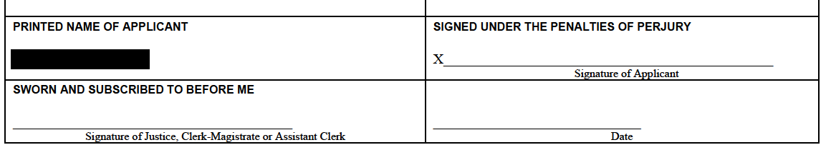
State Judicial Warrants, Continued
Must be signed by Judge, Clerk Magistrate or Assistant Clerk
This presentation is for informational purposes only. For legal advice, please contact an attorney.

Slide 11

If Immigration Comes to Your Home
Stay calm, take a deep breath
Legally, you do not need to open the door unless the officer provides you with a warrant signed by a judge
You may ask officers to identify themselves (agency, name, ID)
You may ask if they have a warrant signed by a judge
You may assert your right to remain silent and to an attorney, including if arrested by ICE. If you choose to invoke that right, state to officers “I request my right to silence and to an attorney”
One way to assert these rights is to slide a “Know Your Rights” card under the door
For help, call a US citizen friend, family member or an attorney
This presentation is for informational purposes only. For legal advice, please contact an attorney.

Slide 12
General Rules & Requirements of ICE
The rules differ based on where ICE is trying to arrest the person
ICE Car Stops With an Administrative Warrant:
ICE Arrests With an Administrative Warrant (NOT IN A HOME):
ICE must have probable cause to believe the person is here in violation of the laws of the United States.
ICE officers are only required to have “reasonable suspicion” of an immigration violation to initiate a car stop
Wearing a Mask:
No known prohibitions
Showing a Badge:
As soon as practicable and safe to do so during arrest.
Interpreted often as at end of arrest
This presentation is for informational purposes only. For legal advice, please contact an attorney.

Slide 13
ICE arrests Outside a Home, Without a Warrant
ICE may make arrests outside the home, in certain circumstances, without a warrant.
NOTE: ICE sometimes has a warrant, even if they will not show it to a bystander.
The Right to Arrest Without a Warrant (NOT IN A HOME):
To arrest a person on the streets or in a car, without a warrant, ICE must have “reason to believe” the individual is
(i) in the US in violation of immigration laws and
(ii) “likely to escape before an arrest warrant can be obtained.”
This presentation is for informational purposes only. For legal advice, please contact an attorney.

Slide 14
Does ICE have to show an administrative warrant?
Regulations refer to ICE “serving” the administrative warrant on the immigrant, but do not directly order the service. 8 C.F.R. sec. 236.1(b).
Who can issue an administrative warrant? The list is long, but includes:
Supervisory deportation officers;
Supervisory detention and deportation officers
Immigration Enforcement Agents; or
Other duly authorized officers or employees of the Department of Homeland Security or the United States who are delegated the authority as provided in 8 CFR 2.1 to issue warrants of arrest, and who have successfully completed any required immigration law enforcement training.
This presentation is for informational purposes only. For legal advice, please contact an attorney.

Slide 15
Rights and Responsibilities of Bystanders
You may bear witness to a public arrest
Physically interfering or verbally berating ICE could have adverse consequences for both you and the immigrant
Rights and Assistance of Bystanders
You can help by keeping calm and promoting calm
Massachusetts law allows for videotaping, if using sound must be open and obvious
You have the right to witness and document
You can ask if the immigrant wants you to call someone
You can offer to help remaining family members by preparing bond packet, offering support
This presentation is for informational purposes only. For legal advice, please contact an attorney.

Slide 16
Helpful Bystander Actions
Think: Who, What, Where, Why, When, How, Describe
Bystander first amendment rights:
Videotaping:
Car license plates (Victim & Police)
Vests of Officers (FBI? ATF? HSI?)
Arrest & Placement in car
Any audio
Bystanders' impressions (after they leave)
Notetaking after the fact:
Who was there
How many people, How long
Describe the officers
Describe number of cars
Any damage to cars/people
If you Choose To help the person arrested:
Ask the person being arrested: Who can we call
Ask if they have an Attorney, get name and #
‘Ask if they have a spouse or child, can you call them, get name and #
Ask them what the language is of the person you are calling and have a translator
PERMISSIONS are important: do I have your permission to call your spouse, your lawyer, can the video be shared?
REMIND people they have rights, read Red cards to the person.
TIME is very important. Tell them you want to call someone fast
This presentation is for informational purposes only. For legal advice, please contact an attorney.

Slide 17

See Something, Say Something
Lawyers and media outlets need specific, verified information
WHAT ARE WE LOOKING FOR?
Random stops, non-targeted enforcement
Violence against immigrant
Harm, mistreatment to children
Harm, mistreatment to pregnant women
Long term residents, green card holders, those w/out any criminal record
Demeaning or outrageous behavior
Violence against bystanders
REPORTS:
ACLU: 617-482-3170
Attorney General (ask for Civil Rights Division) (617) 963-2000.
LUCE: 617-370-5023

Slide 18
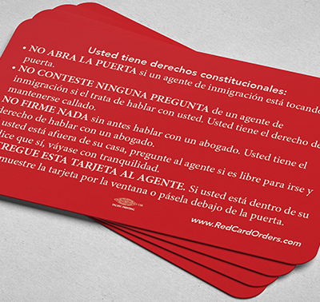
Know Your Rights Cards
Multilingual Infographic for Using Rights Card
Asserting the right to remain silent can be difficult.
It is helpful for people to have a rights card in their wallets that they can pull out and give to immigration agents or police.
The Right to Remain Silent and an Attorney applies to ALL law enforcement encounters
https://www.ilrc.org/red-cards
This presentation is for informational purposes only. For legal advice, please contact an attorney.

Slide 19
Working With Lawyers
Immigration law is extremely complicated
Private Attorneys:
Flat fees versus hourly
Payment plans
Factors to consider:
Public Discipline – check the BBO website
Online ratings
Word of Mouth
Referral basis
Experience
Do they do bond/removal defense?
Are they a member of AILA?
How often do they represent immigrants?
When is the last time they went to court?
https://www.massbbo.org/s/attorney-registration
Refunds
Legal Services Lawyers
Sometimes long waitlists
Often more in-depth representation
Free service
Different models:
Direct representation
Finding Pro-Bono assistance
Intake
Does not mean they will take case
Limited detained work
This presentation is for informational purposes only. For legal advice, please contact an attorney.

Slide 20

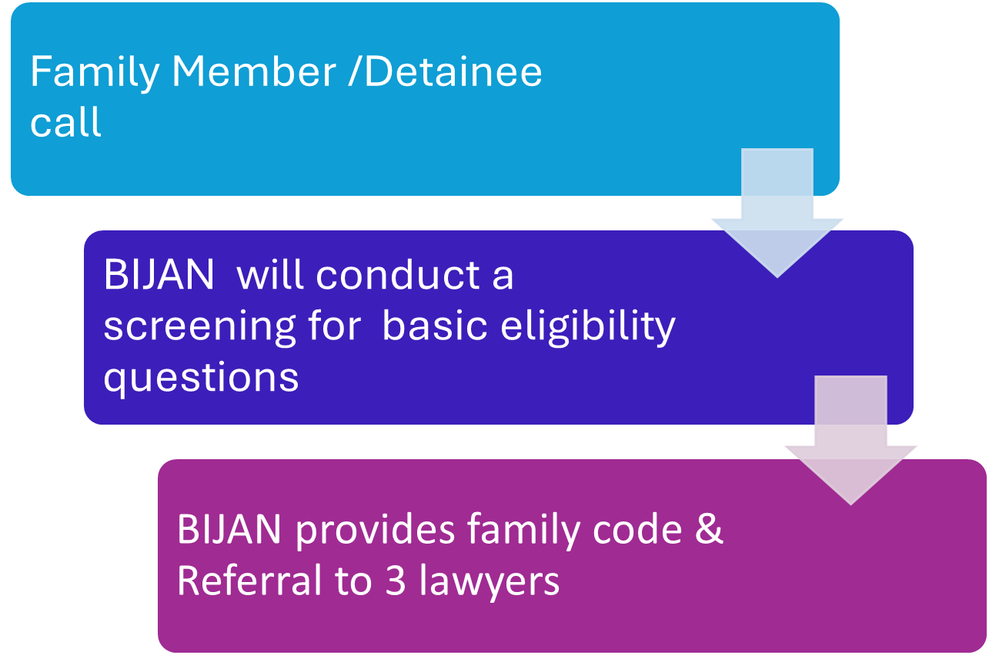
Legal Representation Fund (LRF)
The Attorney General's office along with ORI’s support, funded and created the “Legal Representation Fund” or LRF
Boston Immigration Justice Accompaniment Network (BIJAN) & the Beyond Bond and Legal Defense Fund (BBLDF) organizes the LFR.
Mission: to help fund free legal representation to detained immigrants who are eligible to request an immigration bond
LRF Intake Process
Phone Numbers to Call:
Detained Hotline: (617)637-8195
Family & Friends Hotline: (617)396-7143
This presentation is for informational purposes only. For legal advice, please contact an attorney.

Slide 21

Habeas Background
Habeas is filed in Federal Court
Venue & Jurisdiction required
Individuals concerned about status should (a) consult with an immigration lawyer now, and (b) if pursuing legal representation, have a signed G28 on file with a lawyer
Mass Specific 48 hour hold rule
Should prevent removal “from jurisdiction” for 48 hours
This presentation is for informational purposes only. For legal advice, please contact an attorney.

Slide 22
Habeas Project: immigrationhabeasproject@gmail.com
Please note – the Habeas Project is only for those with immigration counsel
Who?
Partnership between AILA Lawyers, Non-profits,
Federal Criminal Defense Lawyers and Civil Litigators
How?
Recruitment to MACDL attorneys
New Training for 100 new lawyers 9/15
Increase capacity to Mass residents held outside state
Emergency Habeas Filing screening:
Lawful Permanent Resident at Airport
Arrests in Immigration Courthouse
Student Visa revocation in violation of constitutional rights
An individual subject to expedited removal
An individual who has humanitarian factors negating against transfer
Unconstitutional Detention
NOTE: ALL need to all be represented by an immigration attorney
This presentation is for informational purposes only. For legal advice, please contact an attorney.

Slide 23
Other Questions:
Locating Family members can take 36-48 hours
How do I locate my family member?
Go to Google
Type “ICE online detainee locator:
You will see this website: https://locator.ice.gov/odls/#/search
Put in family members name, country of origin and A number
NOTE: Maine is different
NOTE: Wrong spelling, etc can delay

Slide 24
Protecting your assets: Homes, Bank Accounts and Businesses
A Limited Power of Attorney gives someone power to act on your behalf
1. What is a Limited Power of Attorney?
It gives a trusted person that you choose the power to access your bank accounts, sell your home, rent your home, engage other employees and generally manage your affairs if you are deported.
2. Can I have a Limited Power of Attorney drafted overseas?
You can use delivery services such as DHL to send the original document back to the agent
You can use a notary overseas to have it notarized, however you also need an apostle and it is very complicated
3. What if I want to revoke the POA?
That can be written into the language of the document
4. What about my bank accounts?
You can allow a co-signer to access your bank accounts
Alternatively, allow the agent of the POA.

Slide 25

At risk? Make A Safety Plan
Consider giving to relevant people:
“Sharing” your location
Name & cell of your lawyer, close family members and G28
Airport Pickup (if you must travel)
Have LPR or US citizen pick you up @ airport
Text when you land, make sure lawyer is on call
Have copies of your G28 and make sure family does
Permission to Represent
This presentation is for informational purposes only. For legal advice, please contact an attorney.

Slide 26
Basics of Family Preparedness
Consider:
Obtaining a Caregiver Affidavit
Deciding who can care for your children if you are unable to
Ensuring school pickup lists are updated
Obtaining passports for all children (especially US or your home country)
Writing down instructions if your child has any medical conditions and/or takes any medications
Keeping a file of important documents
ICE detainee locator:
https://locator.ice.gov/odls/homePage.do.
This presentation is for informational purposes only. For legal advice, please contact an attorney.

Slide 27
Family at Risk? Make a family plan
Massachusetts Planning for those with uncertain immigration status:
https://www.mass.gov/emergency-planning-guide-for-families
Boston Medical Center Family Plan:
https://www.bmc.org/sites/default/files/Patient_Care/Specialty_Care/IRHP/family_preparedness_plan.pdf
This presentation is for informational purposes only. For legal advice, please contact an attorney.

Slide 28

Resources
Many family planning documents can be done without an attorney
Resources for Immigrants in Massachusetts | Mass.gov – Ag’s office website about family planning and non-discrimination, including worker’s rights
ORI’s toolkit: Community Resource Toolkit | Mass.gov – Spanish, Haitian Creole, Portuguese family planning forms.
Emergency Planning Guide for Families | Mass.gov – provides further documents and resources

Slide 29
Immigration Legal Resources
It may take time to find a provider, please use trusted providers and check references.
Legal Services Directory in Massachusetts:
Massachusetts Legal Resource Finder:
Legal Services Directory Outside of Massachusetts:
Immigration Advocates Network Legal Directory: https://www.immigrationadvocates.org/legaldirectory/
List of Immigration Groups:
https://www.boston.gov/departments/immigrant-advancement/free-immigration-consultations.
MIRA immigration helpline:
https://miracoalition.org/news/immigration-helpline/
https://masslrf.org/en/home
City of Boston free consultations:
https://www.mass.gov/info-details/immigration-legal-support#free-immigration-legal-clinics
This presentation is for informational purposes only. For legal advice, please contact an attorney.

