Slide 1
EOHLC Funding and Oversight of Public Housing
Fatima Razzaq, EOHLC

Slide 2
Overview: Public Housing
Public Housing is affordable housing which is subsidized on both the development and operating side
There are two kinds of Public Housing: Federal and State
Every state in the country has Federal Public Housing
Only 4 states also have a state-aided portfolio, with the Massachusetts portfolio being the largest
Federal Public Housing is subsidized and overseen by HUD
State Public Housing is subsidized and overseen by EOHLC

Slide 3
Housing Bond Bill
What does a bond bill do?
Bond Bills are filed every 5 years
Authorizes a ceiling of spending in capital programs, not a minimum or a budget
Includes policy proposals as well
IMPORTANT TO NOTE:
Our ultimate spending numbers are set by the Executive Office for Administration and Finance (A&F), and may not reach the high amounts set in the bond bill.

Slide 4
Overview of EOHLC Structure
EOHLC’s Division of Public Housing is split into two main Bureaus: Housing Management and Housing Development and Construction
The Bureau of Housing Development and Construction is made up of the following units:
Project Management
Architects and Engineers
Construction Advisors
The Bureau of Housing Management is made up the following units:
Housing Management Specialists
Facilites Management Specialists
Every LHA has an assigned person from each unit dedicated to helping it implement capital projects. LHAs should be very familiar with their team and in constant contact throughout the lifespan of a project

Slide 5
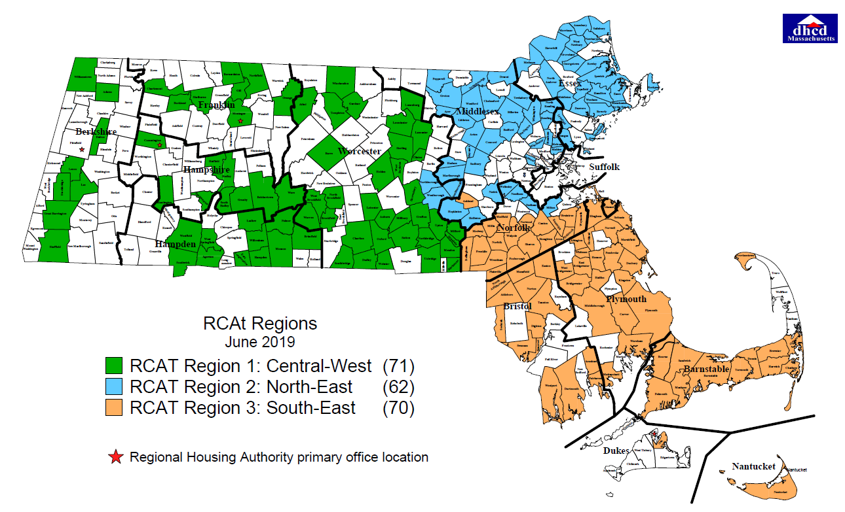
Regional Capital Assistance Teams (RCATS)
LHAs with under 500 state-aided public housing units may be a part of the RCAT program
RCATs deploy an additional team to assist LHAs with implementing their capital projects under $150,000
RCATs also help LHAs put together their CIPs and serve as a resource during the plan creation process
There are 3 RCAT teams that each cover their own geographic area:

Slide 6
EOHLC funding types
Capital Funds
Operating funds
Capital funds support capital construction projects on the LHA’s buildings and sites.
Examples of acceptable uses:
Roof replacements
Paving
Installation of new windows
Elevator repairs
Operating funds support the LHA’s day-to-day operations.
Examples of acceptable uses:
Gutter cleaning
Maintenance upkeep
Snow removal
Office staff

Slide 7
Formula Funding
Formula Funding is an LHA’s share of EOHLC’s bond cap, allocated on an annual basis. In fiscal year FY25 Formula Funding is budgeted for $67.5M
The amount of Formula Funding that an LHA receives is based on their need and size of their portfolio.
Need is determined based on the condition of the LHA’s existing buildings as reported in CPS, our Capital Planning System. Every five years EOHLC procures a state-wide facility condition’s assessments to inform formula funding allocations.
CPS catalogues the condition of every building and site in the state housing portfolio. LHAs update CPS as projects are completed.
A CIP will focus mostly on Formula Funding spending. LHAs program their formula funding allowance through CIPs, and apply for competitive funds through periodic grant rounds.

Slide 8
Pieces of The Bond Cap Pie

Slide 9
Public Housing Innovations
PHI:
Provides capital grants for the redevelopment of a state-aided public housing development as a mixed-income development with a 1-for-1 replacement of state-aided public housing and the development of new market rate and/or affordable units.
The intent of PHI is to leverage the value of LHA land in strong housing markets to attract private funds for the redevelopment of state-aided public housing, while also promoting general housing production and in-fill, transit-oriented development in the Commonwealth.
PHI awards up to a maximum of $250,000 per unit in planning, design, and construction funding to LHAs who have partnered with a developer to pursue the project.
Gateway Cities Neighborhood Revitalization:
Provides capital grants for the redevelopment of state-aided public housing in a Massachusetts Gateway Municipality.
Projects will be significant modernization associated with a broader economic development and/or neighborhood revitalization strategy.

Slide 10
Periodic Monitoring Reports- PMR
LHAs are assessed on a biannual basis on their
Administrative operations
Maintenance operations
These assessments are scored, LHAs receiving scores below a 65 are considered failing and receive a “strike”
If an LHA receives a strike, they are assessed again within a year and must create a corrective action plan that details how they will address the noted issues
LHAs that receive 3 strikes are deemed “Chronically Poor Performing” and EOHLC may appoint a Chief Administrative Financial Officer to come in and run operations in place of the Executive Director

Slide 11
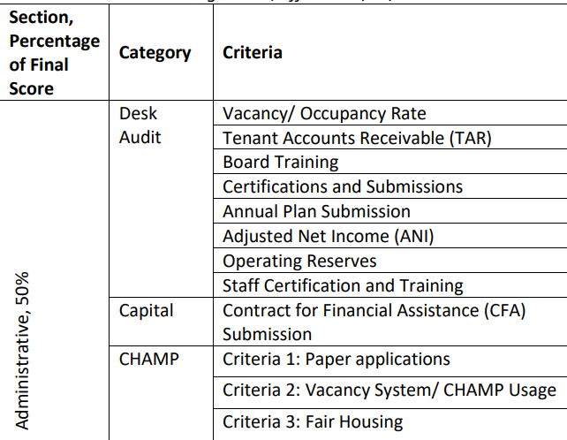
PMR: Admin

Slide 12
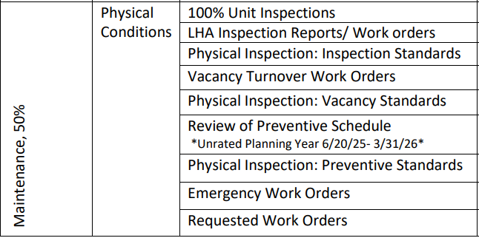
PMR: Maintenance

Slide 13
Agreed Upon Procedures (AUP)
Biannual audits of housing authority finances and procurement procedures
These are completed by CPA Firms
AUPs with failing scores also contribute to an LHA’s strike count

Slide 14
Annual Plan
The annual plan is a required report compiled by the LHA on an annual basis
It includes:
1. A copy of the submitted CIP for that year
2. Copies of the LHA’s policies
3. Formal written responses by the LHA to any findings in their PMR or AUP
The annual plan is a publicly posted and accessible document

Slide 15
Questions?

